Slide 1
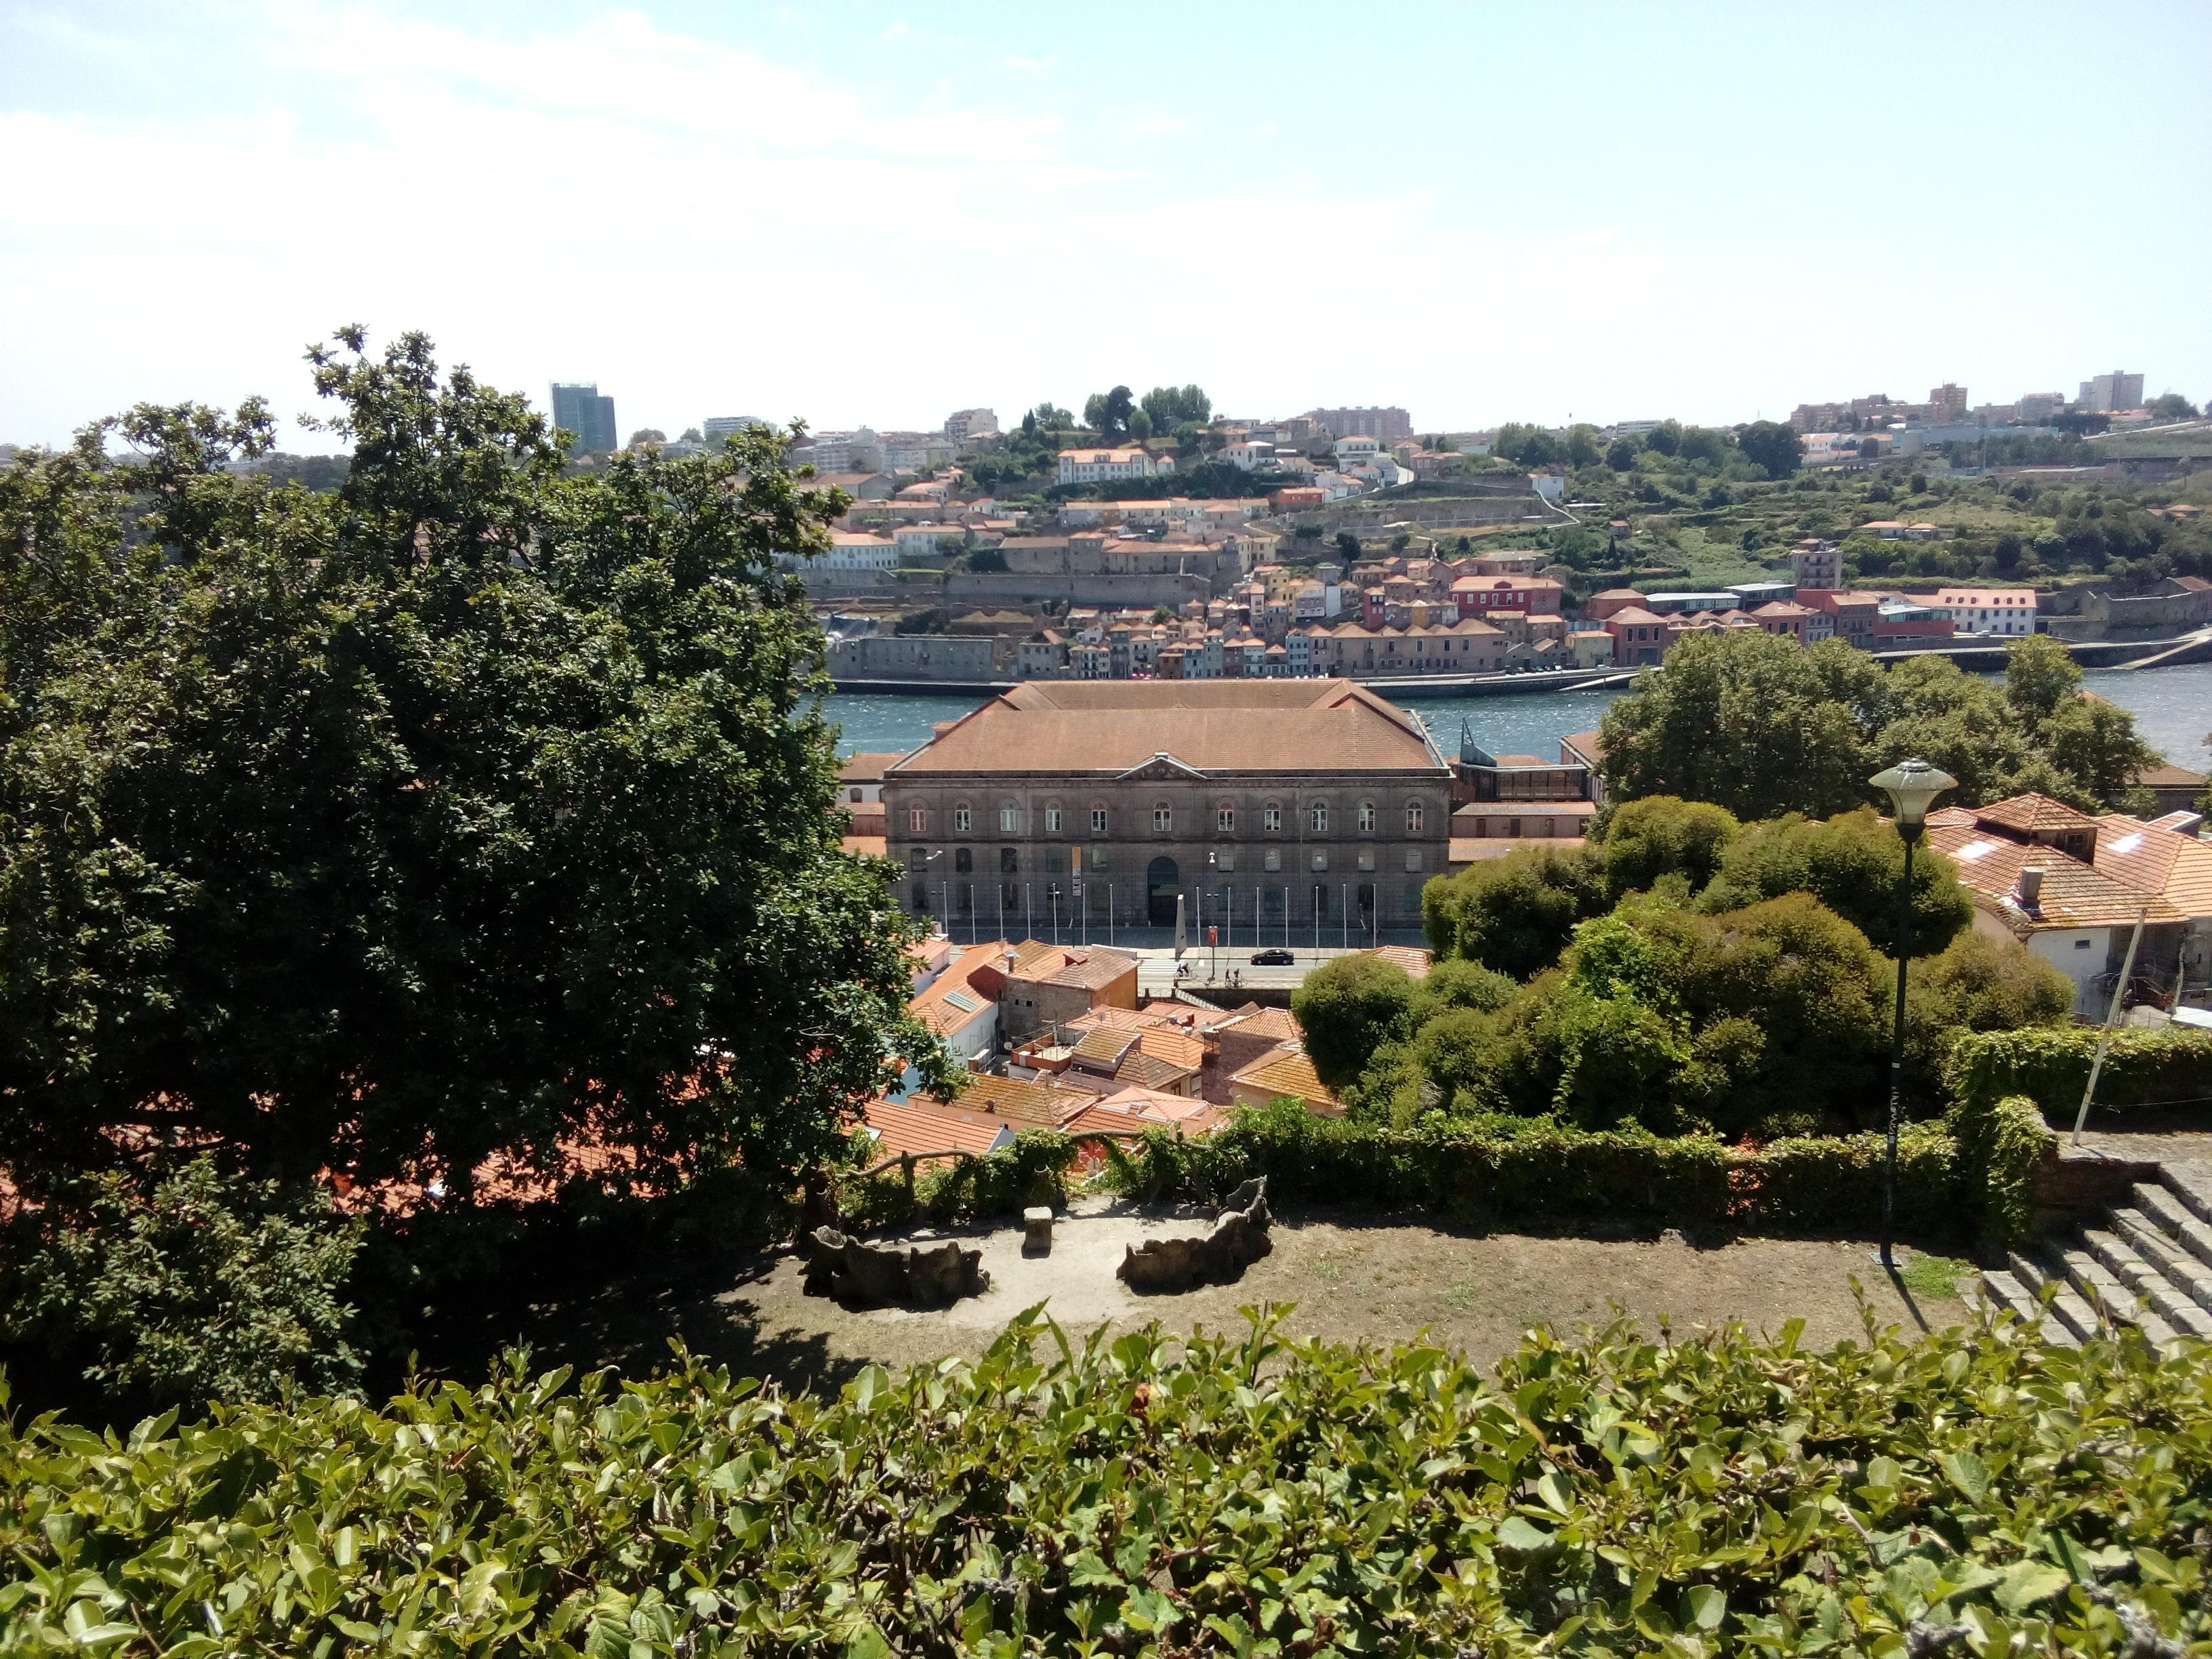
IACM 2018 - Education Programmes at the Customs Museums
Portuguese Customs Museum – Porto
Customs in sight?
Follow the clue!

Slide 2
. Junior University - Summer Junior Campus . Partnership with Porto University . 4 weeks of July . About 300 participants with 11/12 years old . 20 days - 20 groups . 3 editions: 2016 – 2017 – 2018
IACM 2018 - Education Programmes at the Customs Museums
Portuguese Customs Museum – Porto

Slide 3
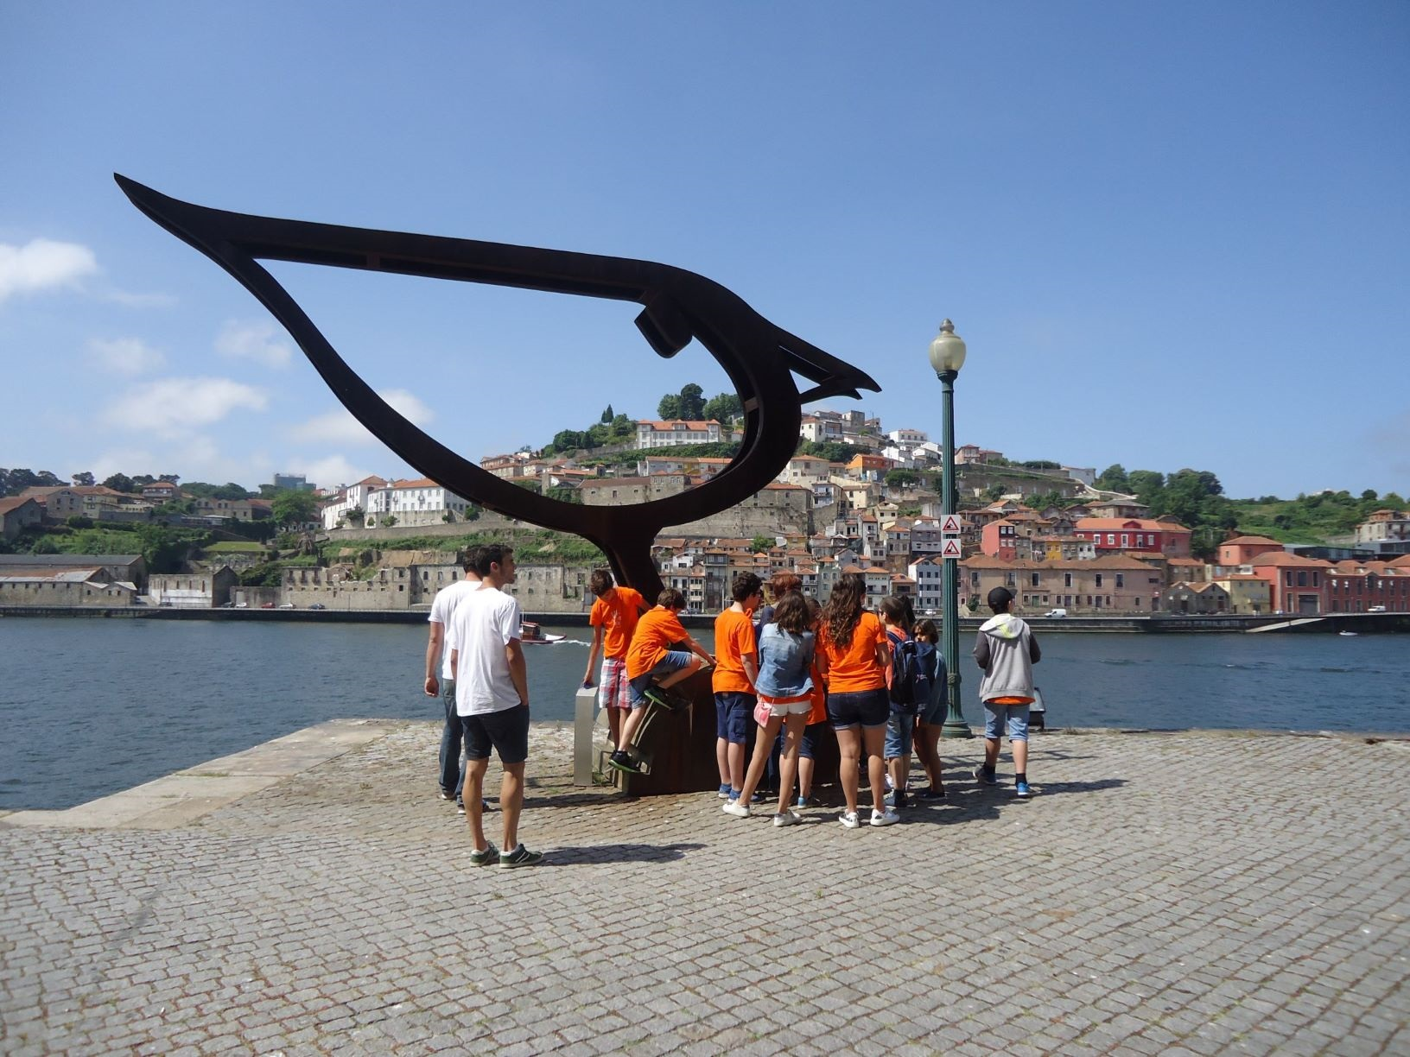
Morning Programme - presentation - treasure hunt at the Customs House
IACM 2018 - Education Programmes at the Customs Museums
Portuguese Customs Museum – Porto

Slide 4
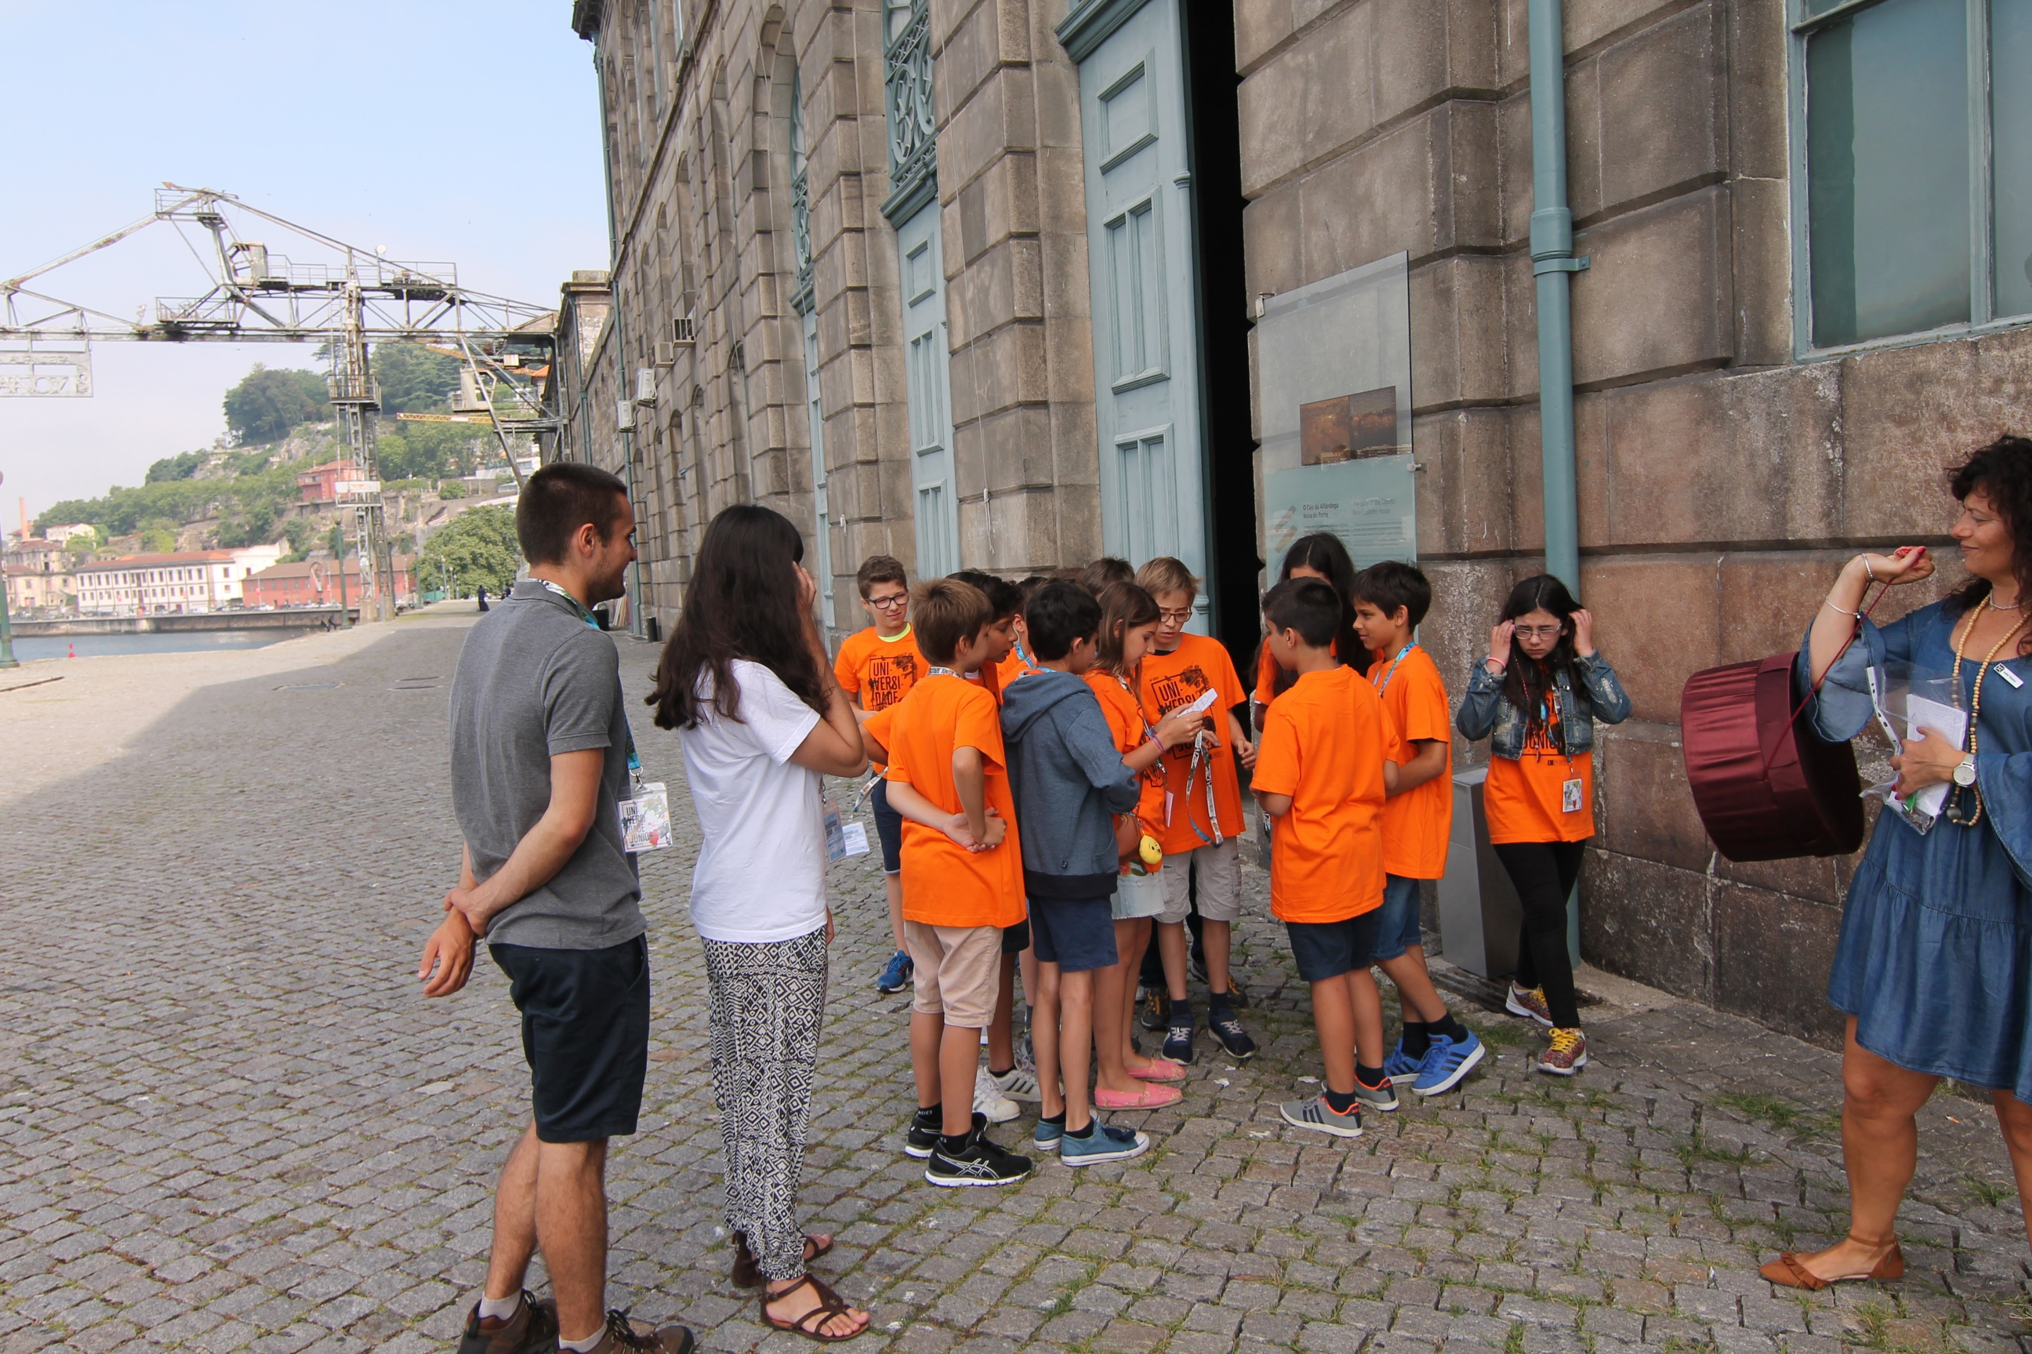
IACM 2018 - Education Programmes at the Customs Museums
Portuguese Customs Museum – Porto

Slide 5
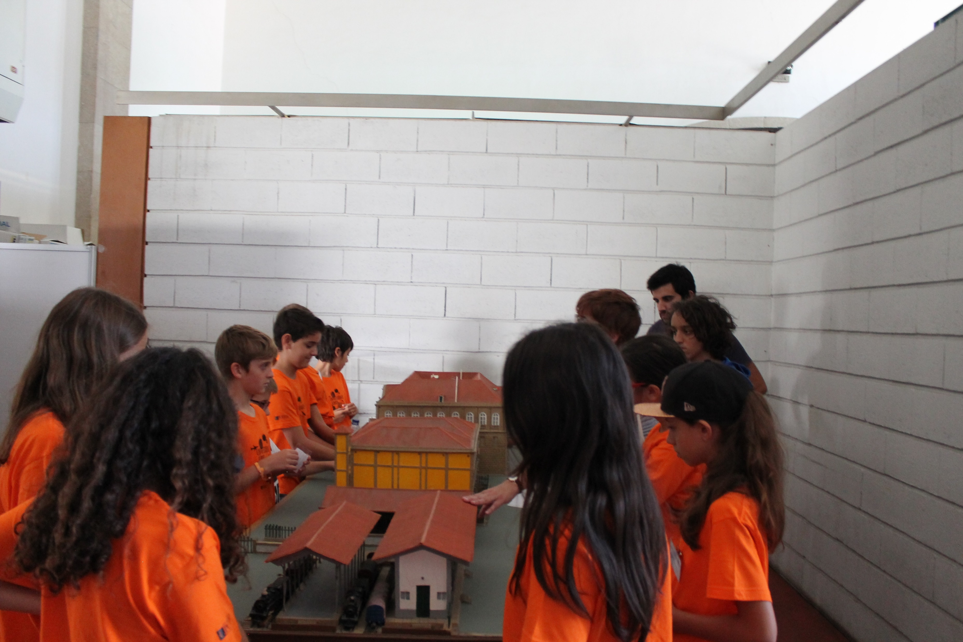
IACM 2018 - Education Programmes at the Customs Museums
Portuguese Customs Museum – Porto

Slide 6
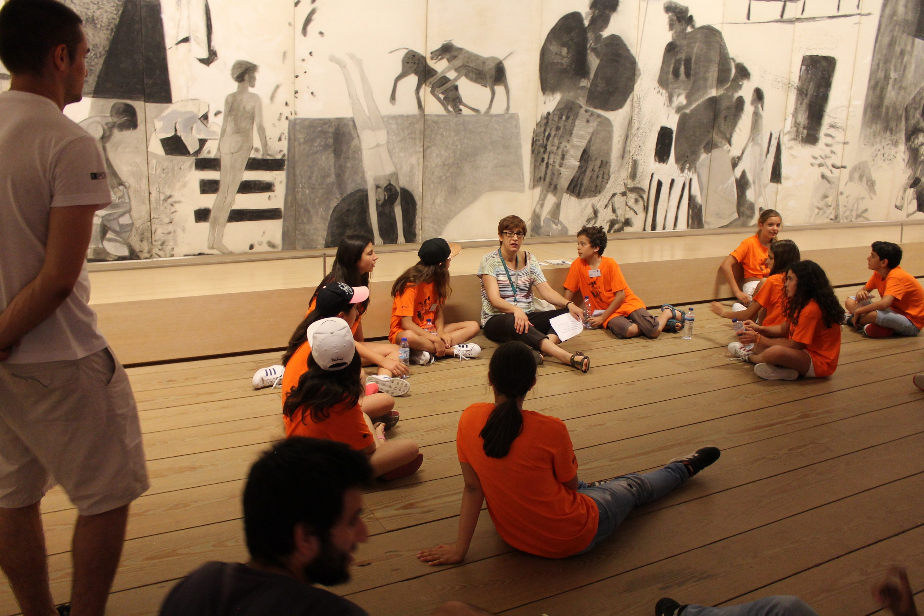
IACM 2018 - Education Programmes at the Customs Museums
Portuguese Customs Museum – Porto

Slide 7
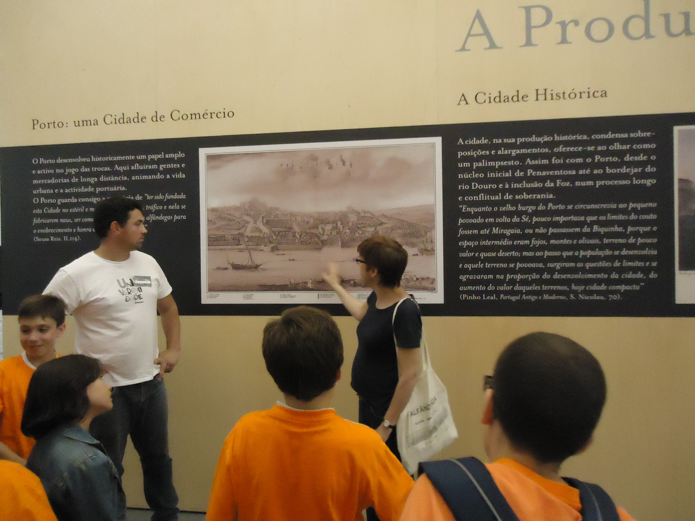
IACM 2018 - Education Programmes at the Customs Museums
Portuguese Customs Museum – Porto

Slide 8
IACM 2018 - Education Programmes at the Customs Museums
Portuguese Customs Museum – Porto
Finaly… the Treasure of North Capitain hidden a long, long time ago in the Customs House

Slide 9
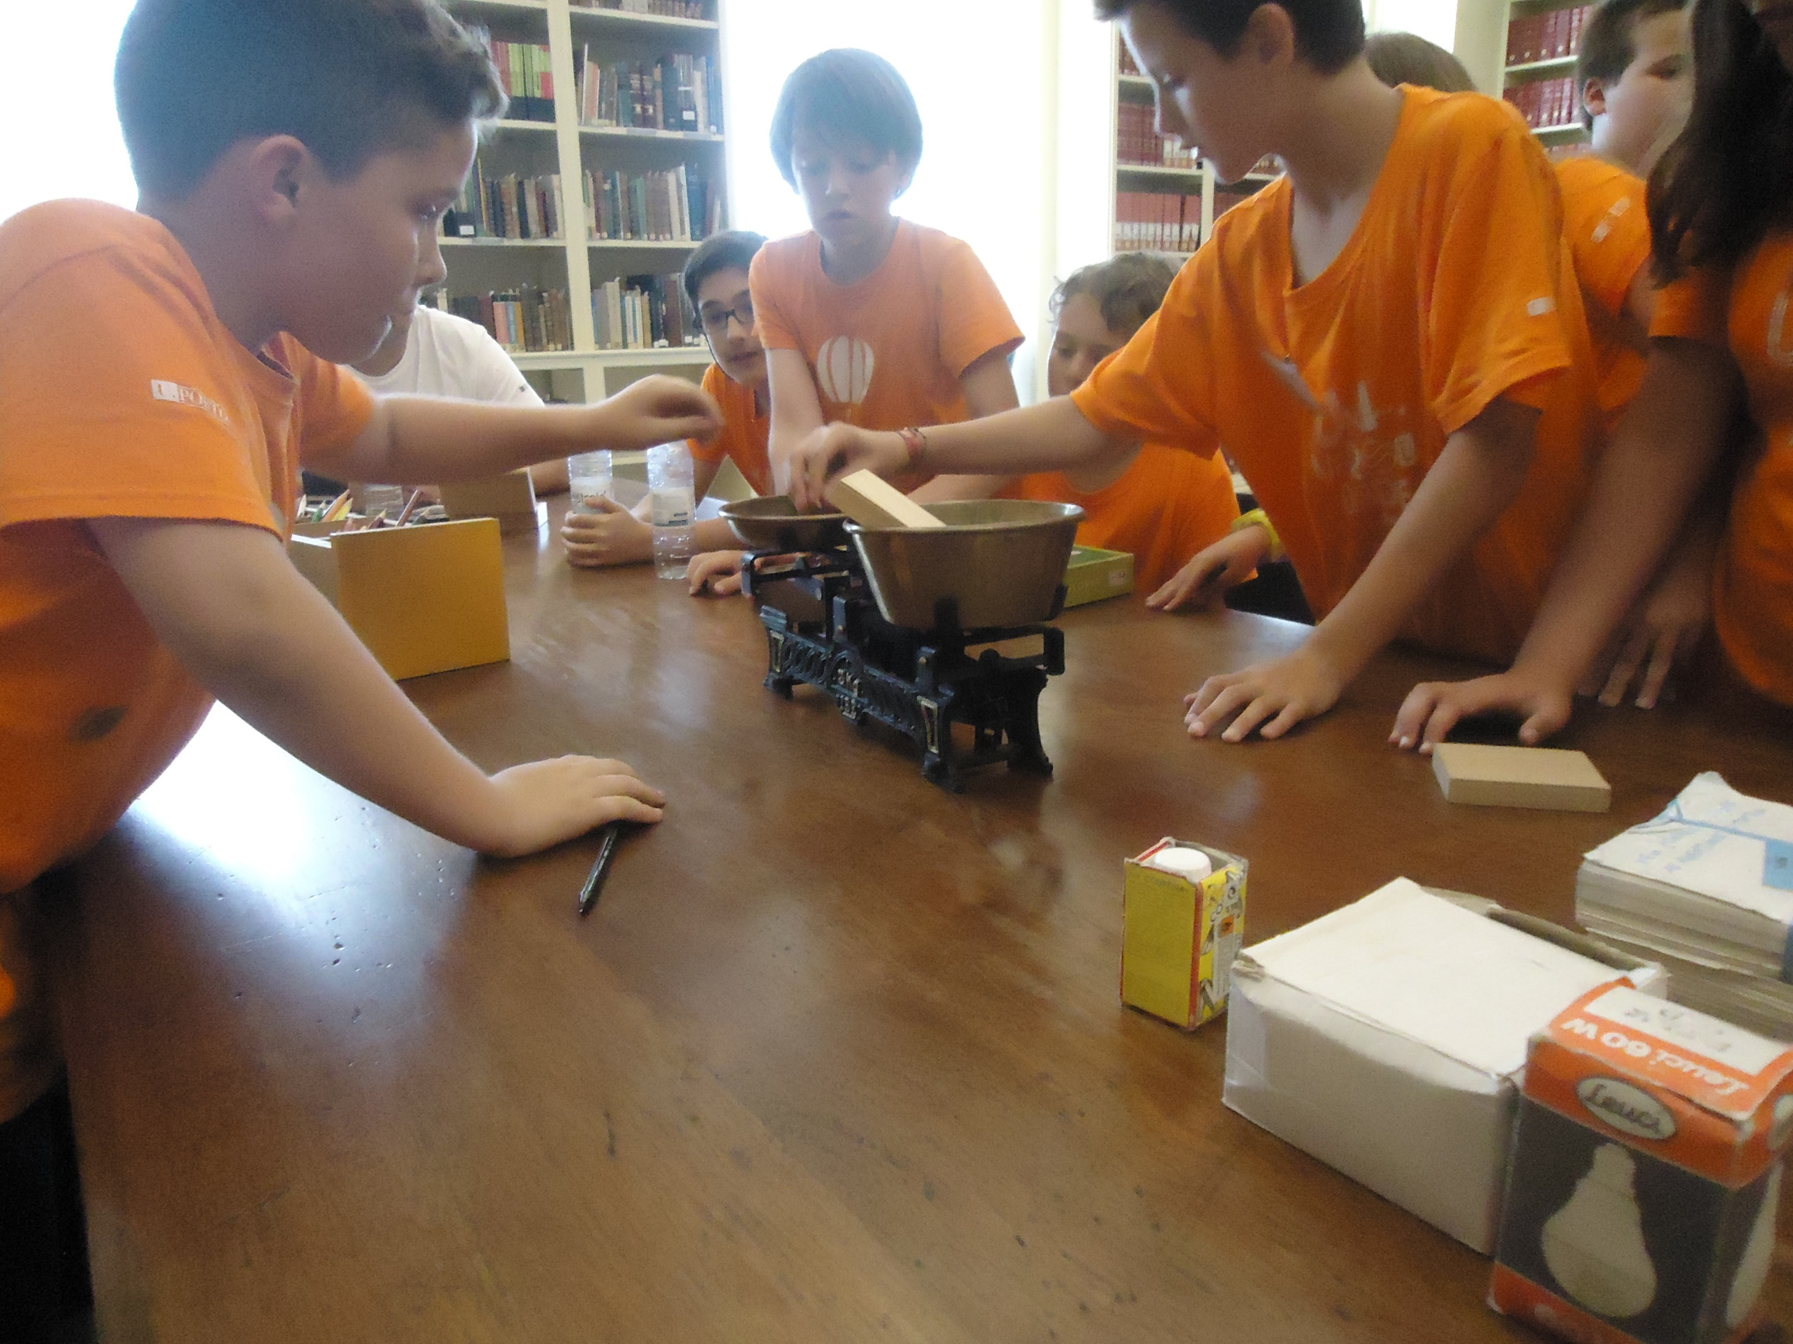
Afternoon Programme - workshop “Hurry and well there is no one! - peddypaper in Miragaia (Customs neighbourhood)
IACM 2018 - Education Programmes at the Customs Museums
Portuguese Customs Museum – Porto

Slide 10
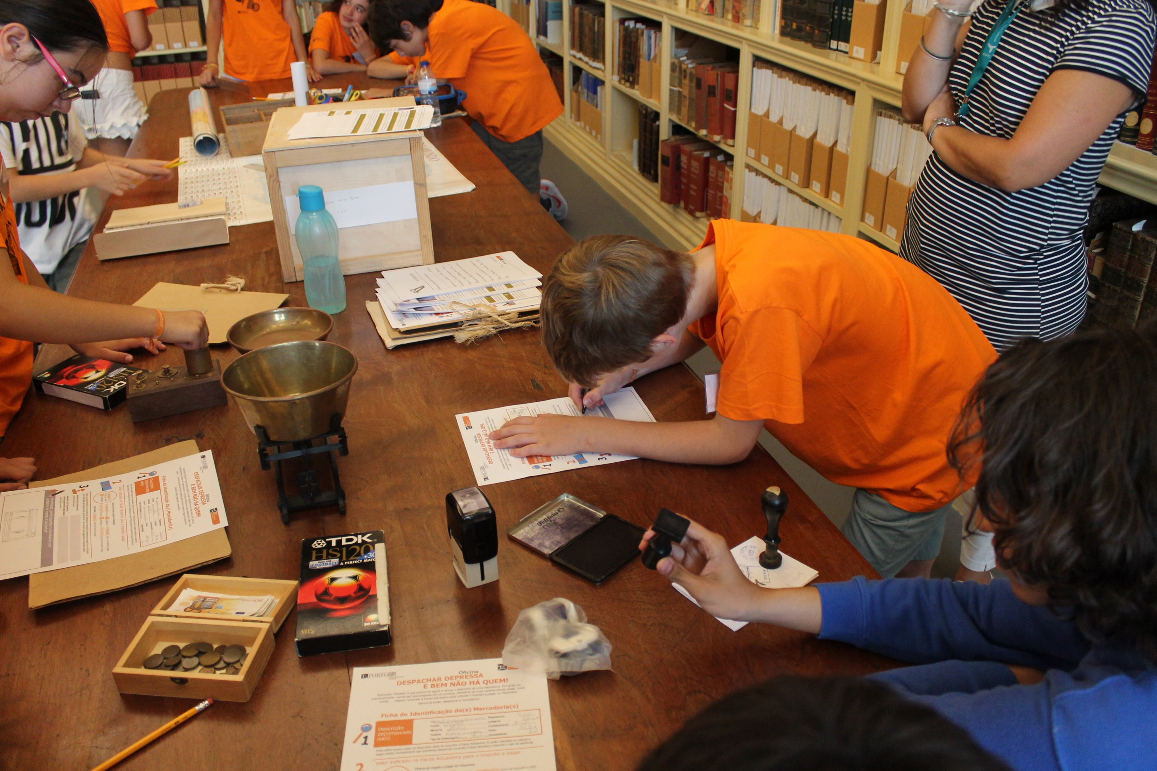
IACM 2018 - Education Programmes at the Customs Museums
Portuguese Customs Museum – Porto

Slide 11
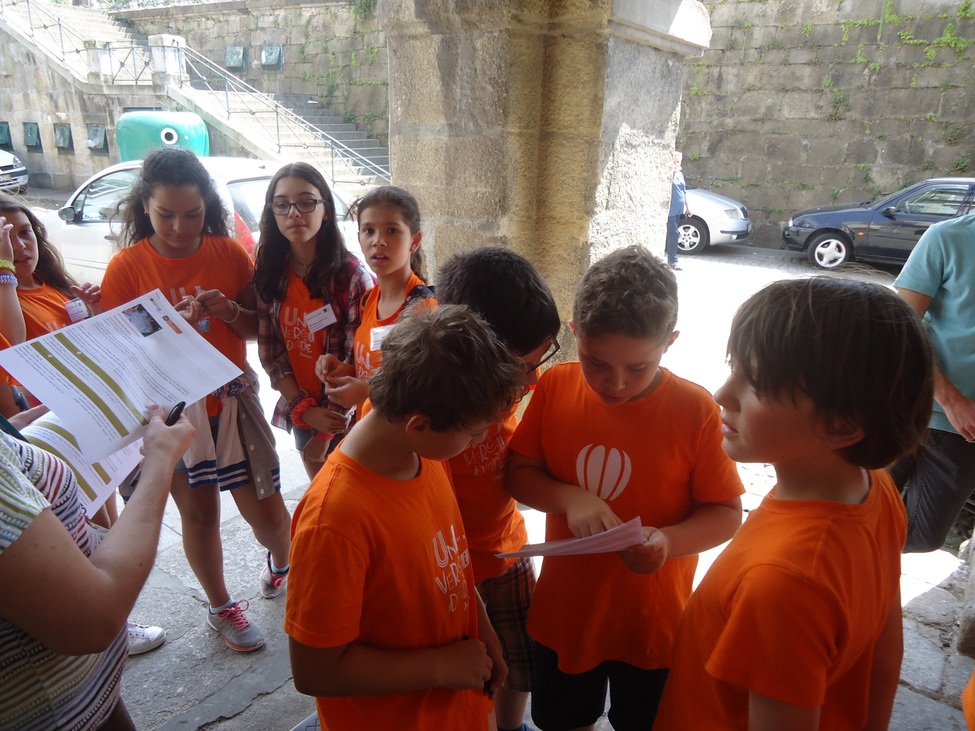
IACM 2018 - Education Programmes at the Customs Museums
Portuguese Customs Museum – Porto

Slide 12
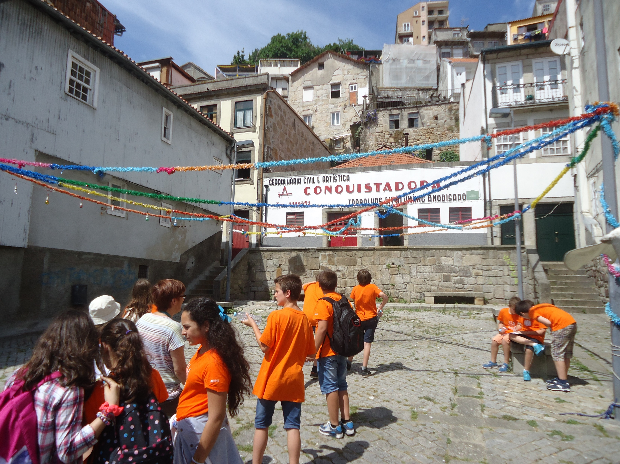
IACM 2018 - Education Programmes at the Customs Museums
Portuguese Customs Museum – Porto

Slide 13
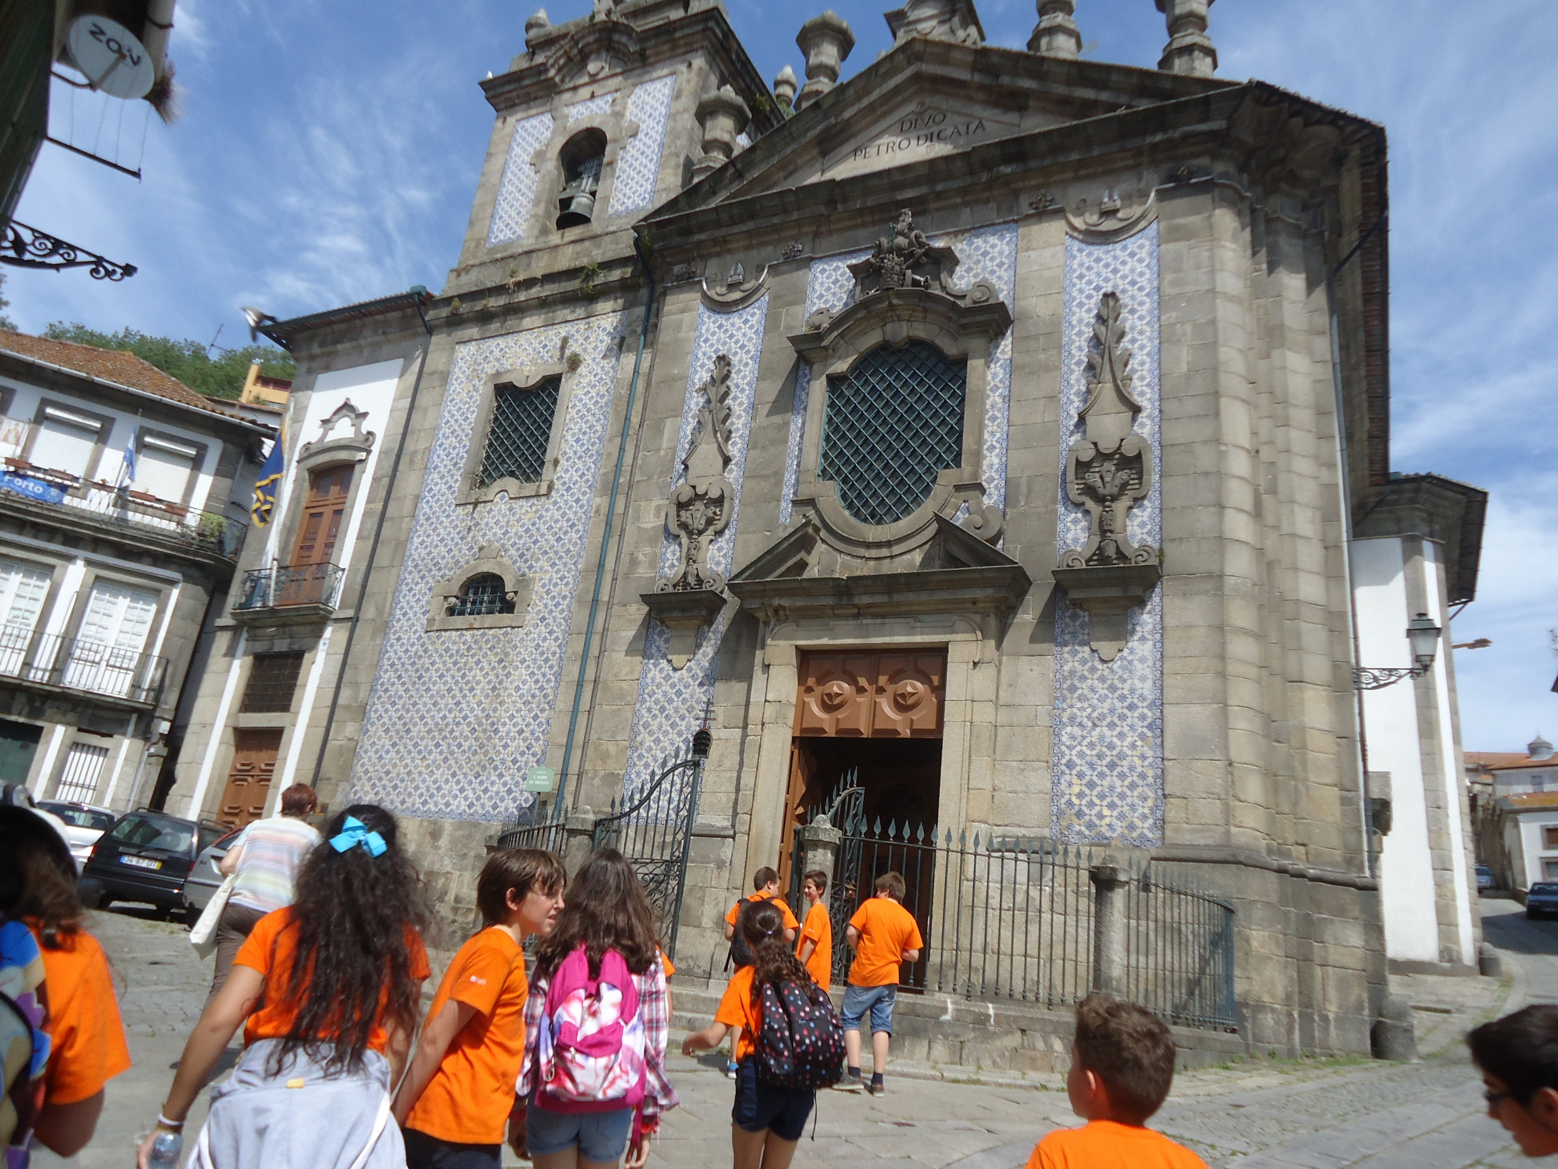
IACM 2018 - Education Programmes at the Customs Museums
Portuguese Customs Museum – Porto

Slide 14
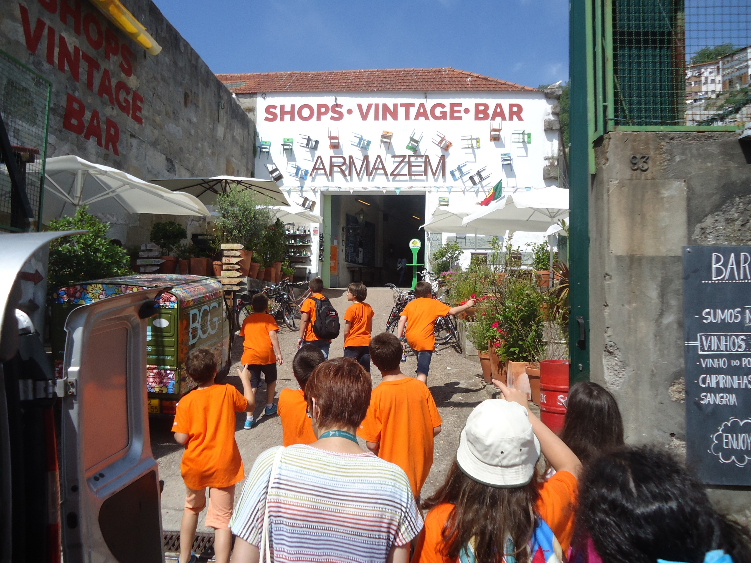
IACM 2018 - Education Programmes at the Customs Museums
Portuguese Customs Museum – Porto

Slide 15
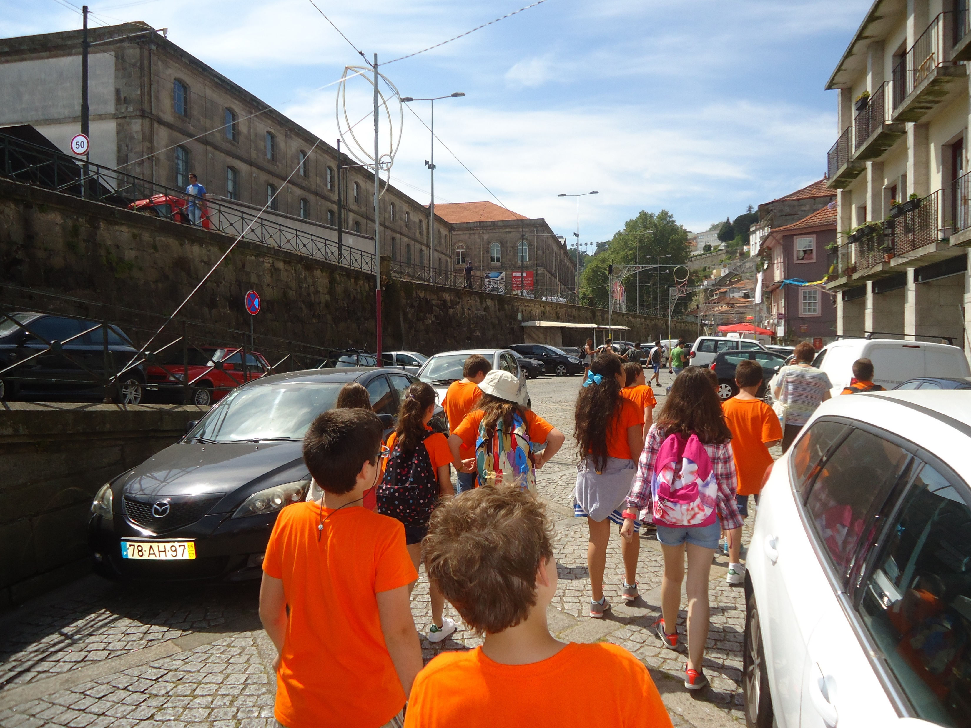
IACM 2018 - Education Programmes at the Customs Museums
Portuguese Customs Museum – Porto

Slide 16
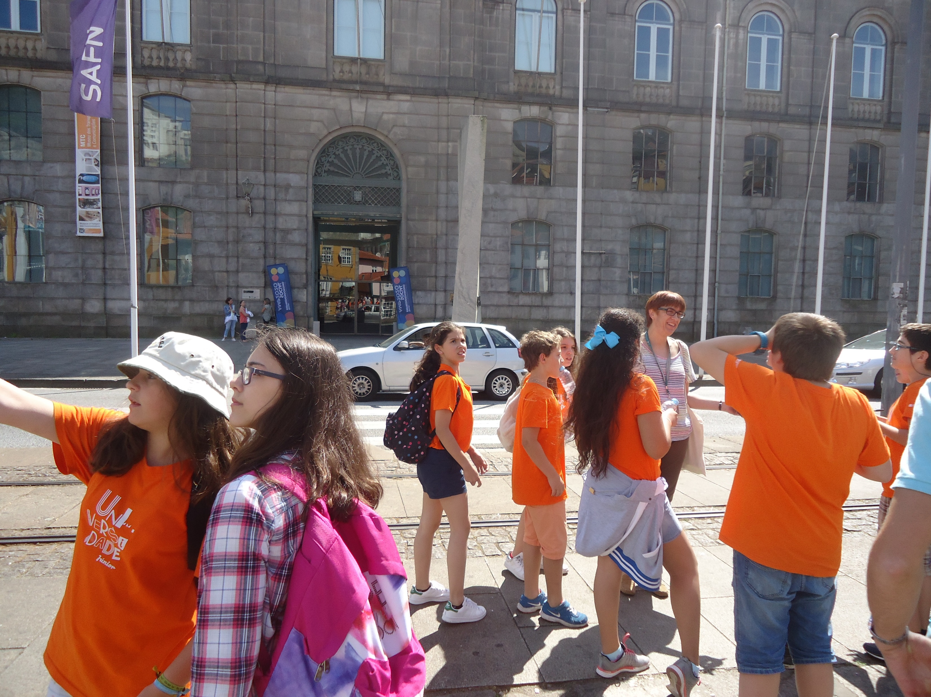
IACM 2018 - Education Programmes at the Customs Museums
Portuguese Customs Museum – Porto

Slide 17
IACM 2018 - Education Programmes at the Customs Museums Portuguese Customs Museum – Porto
Objectives:
Share knowledge about Customs House history
Promote the pleasure about knowledge and protection of the city heritage
Involve the young students in fun and experimental activities (learning by playing)

Slide 18
IACM 2018 - Education Programmes at the Customs Museums Portuguese Customs Museum – Porto
Objectives:
Promote “Museum New Publics” (return of the young students to visit the museum with their families)
Reinforcement the relation between Museum and Porto University (AMTC associated)
Reinforce the European Year of Cultural Heritage celebration

Slide 19
IACM 2018 - Education Programmes at the Customs Museums Portuguese Customs Museum – Porto
Portuguese Customs Museum:
a Museum of all… made by all

Slide 20
IACM 2018 - Education Programmes at the Customs Museums Portuguese Customs Museum – Porto
Thank you!
Adriana Almeida
adrianaalmeida@amtc.pt
museu@amtc.pt

