Slide 1
Education rocks
take
your
chances

Slide 3
take
your
chances
1
A pragmatic approach
the start of something new
2
Bring in THE TEAM
team skills based on experience
in education or the cultural sector
3
KNOW YOUR CUSTOMER
the desires and needs from the educational side
4
Survey the value
evaluating usefulness by questioning the pupils
Find yourself some partners
5
cooperation is necessary
Become Future proof
6
never stop developing

Slide 4
A pragmatic approach
take
your
chances

Slide 6
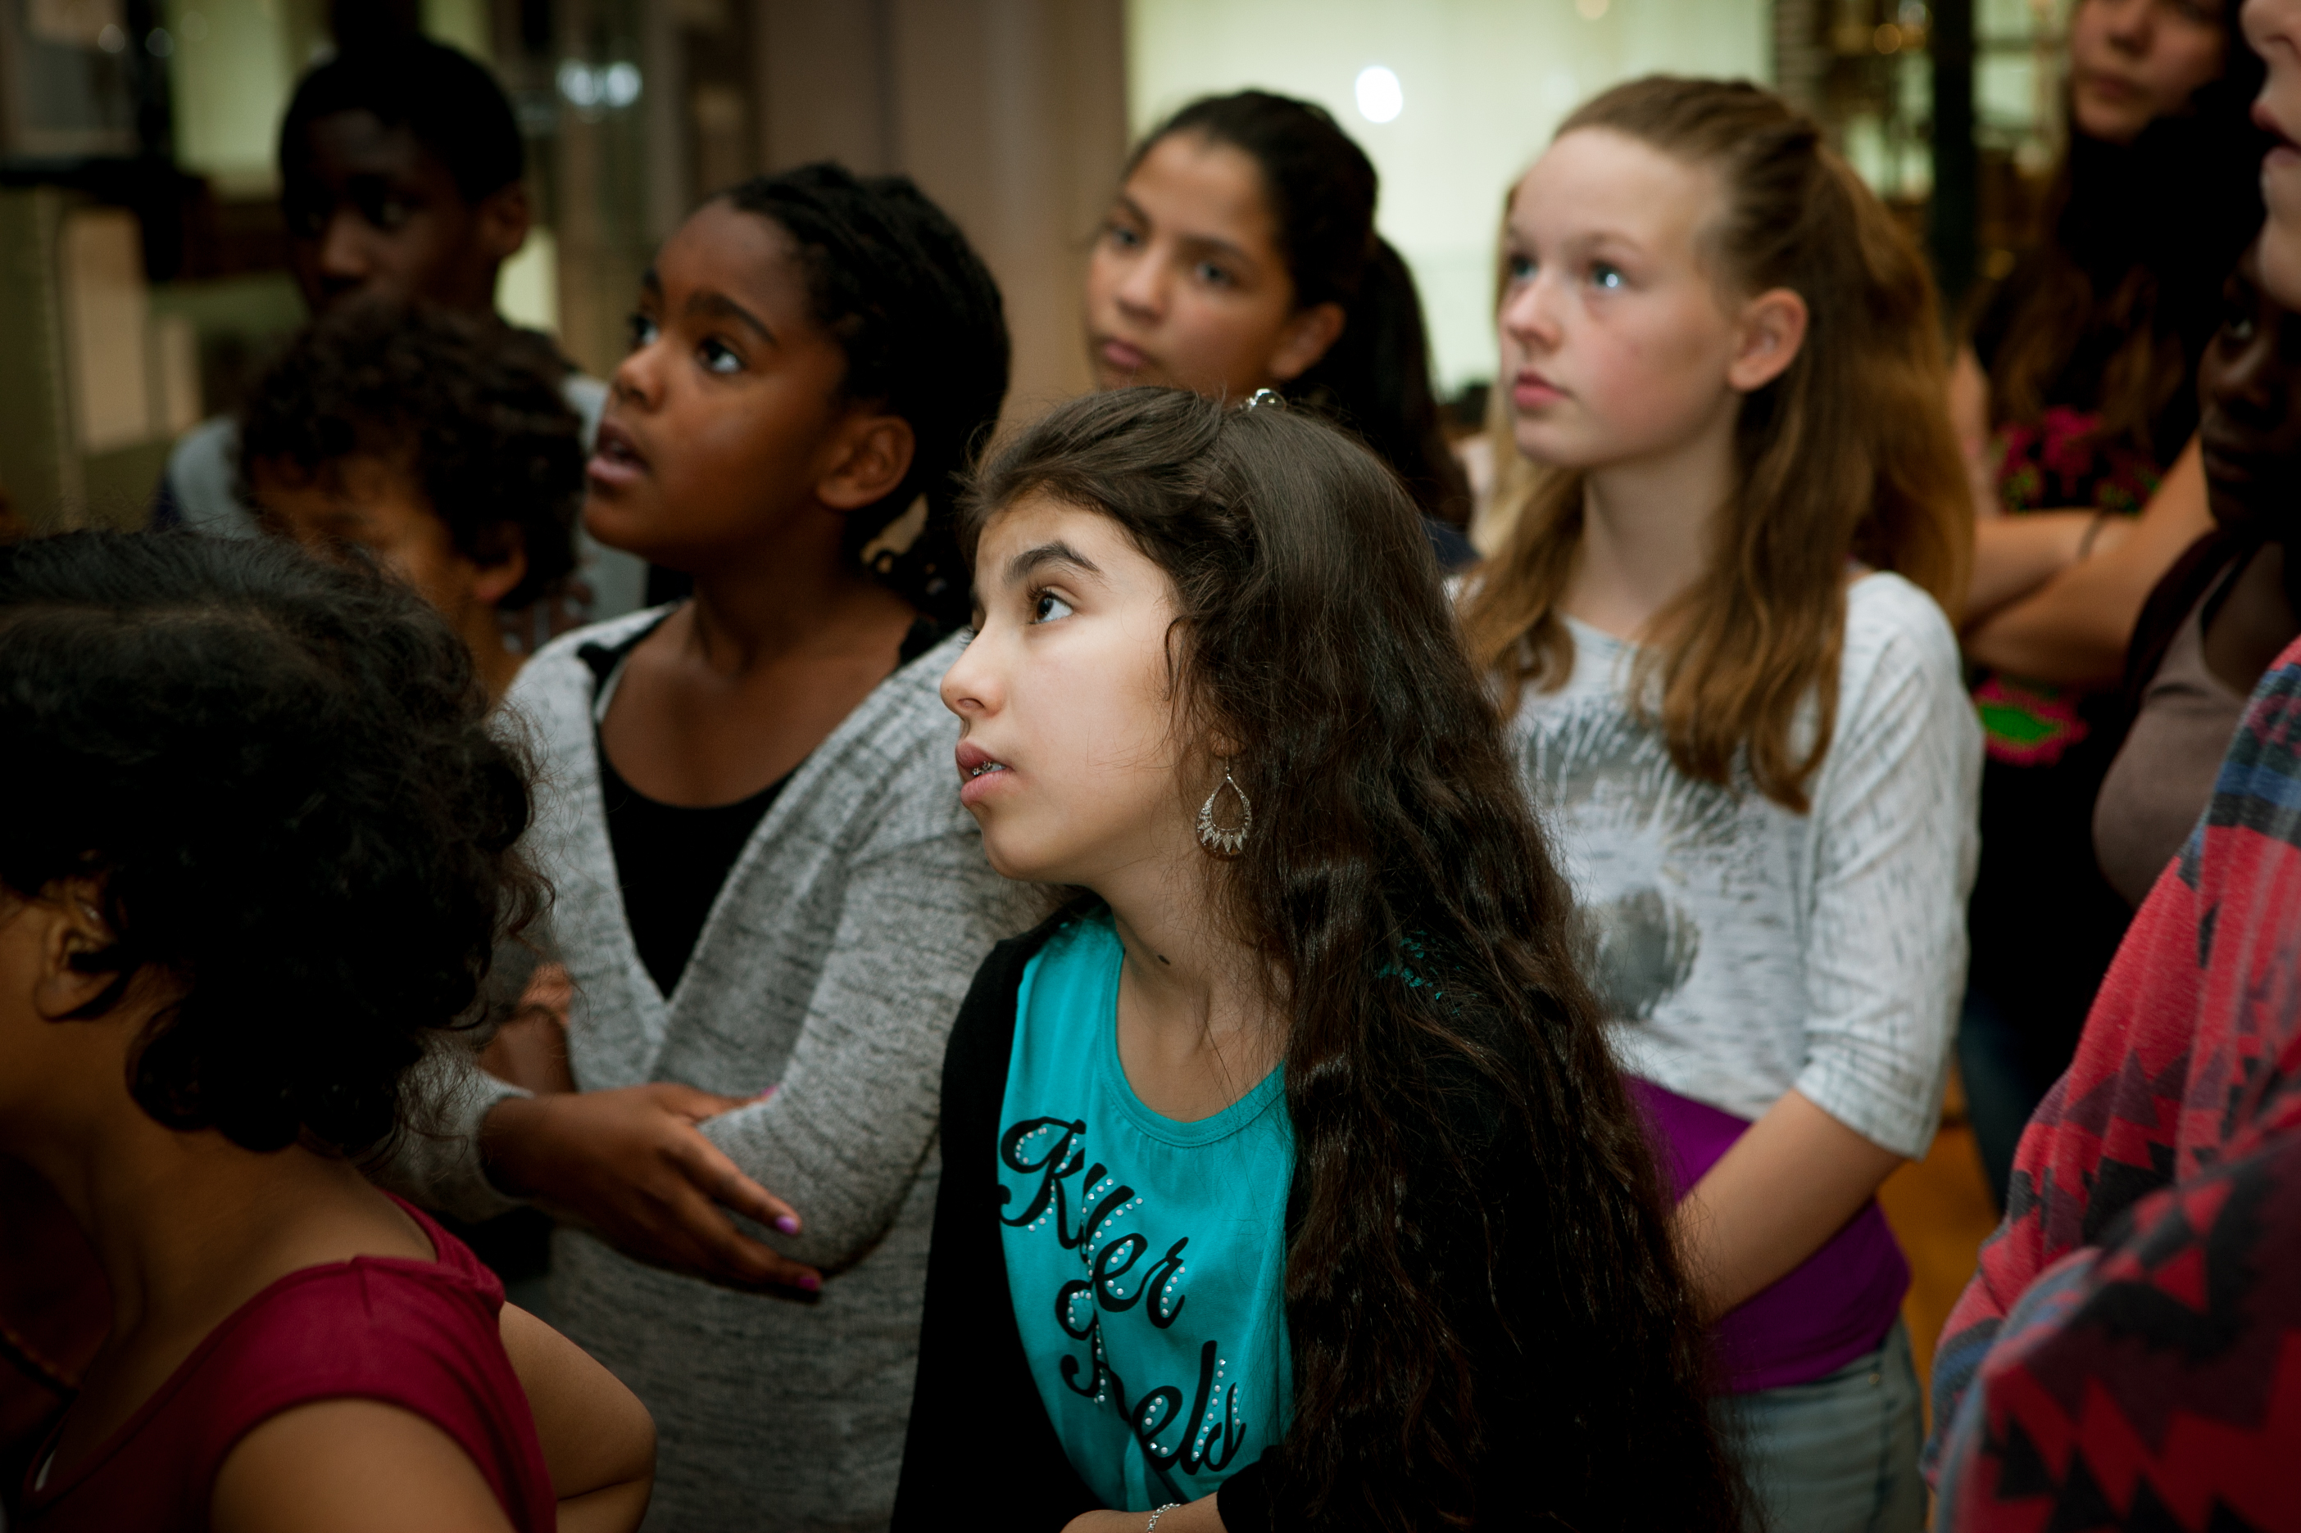

Slide 7
Bring in THE TEAM
take
your
chances

Slide 9
KNOW YOUR CUSTOMER
take
your
chances

Slide 10
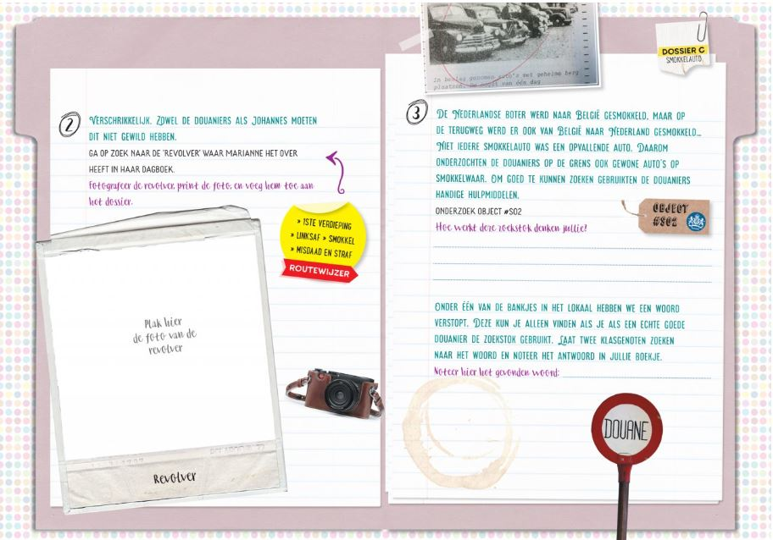
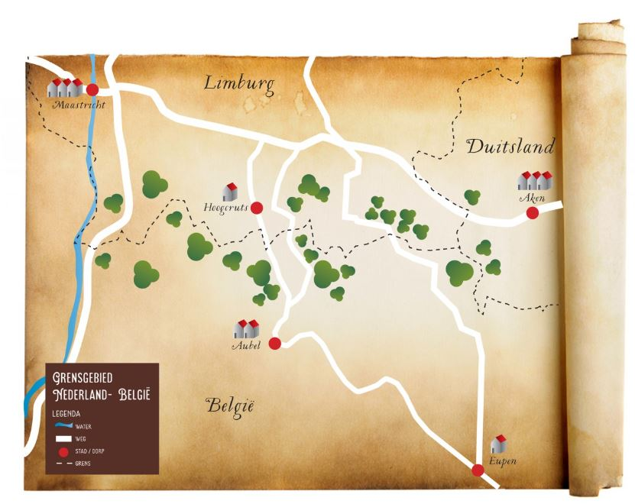

Slide 11
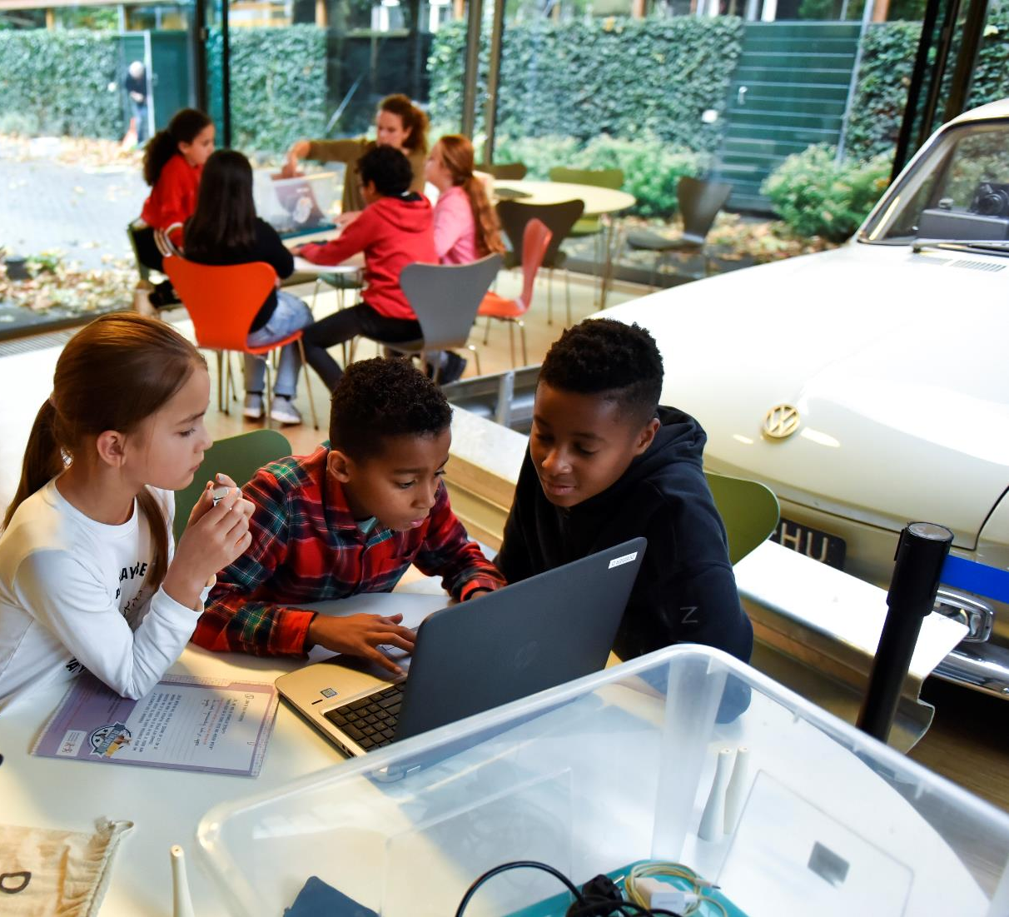

Slide 12
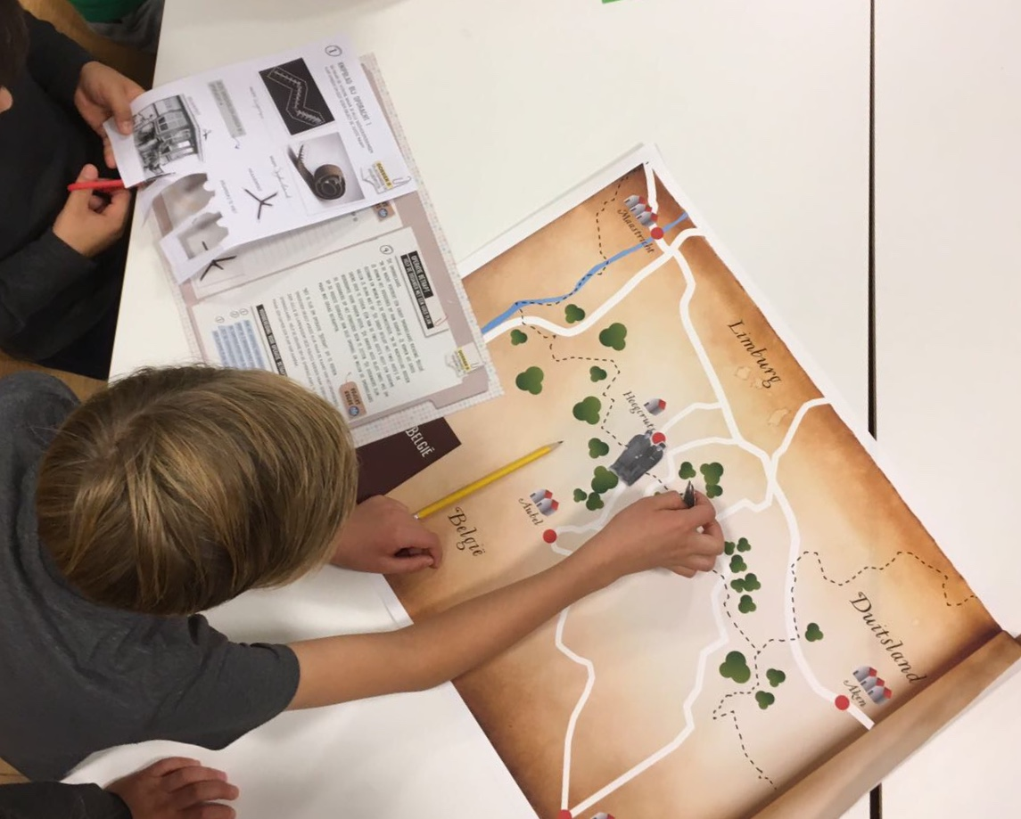

Slide 13
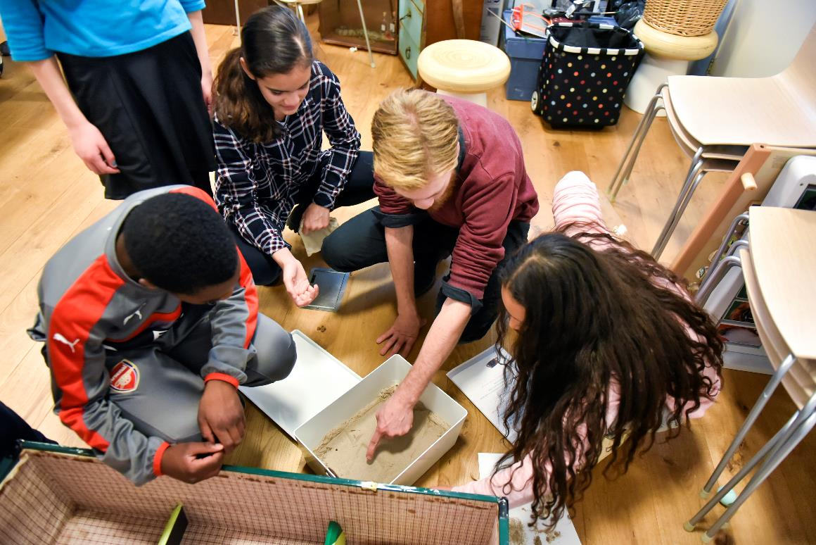

Slide 14
Survey the value
take
your
chances

Slide 15
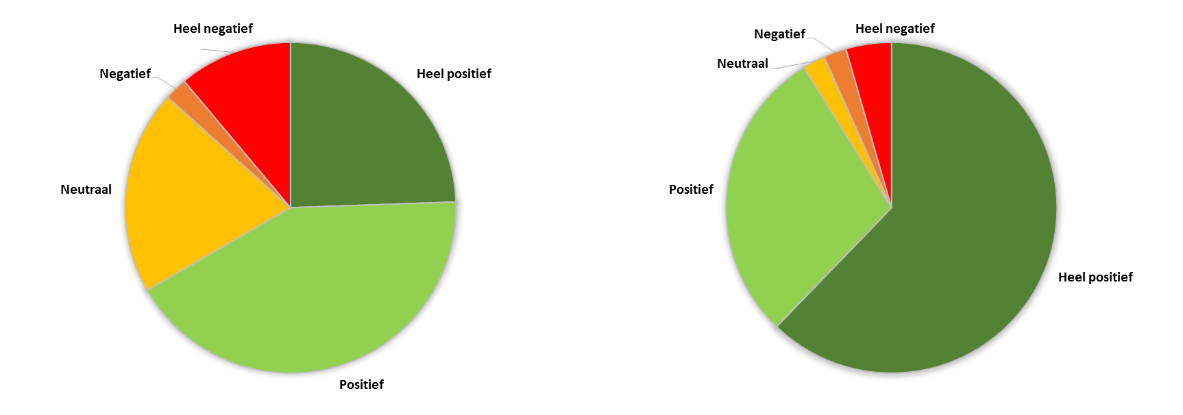
Q: Did you like working on the program ‘Caught out!’?
Q: Did you like working with the educational materials of the program ‘caught out!’?
Very negative
Negative
Very negative
Negative
Very positive
Neutral
Neutral
Positive
Very positive
Positive

Slide 16
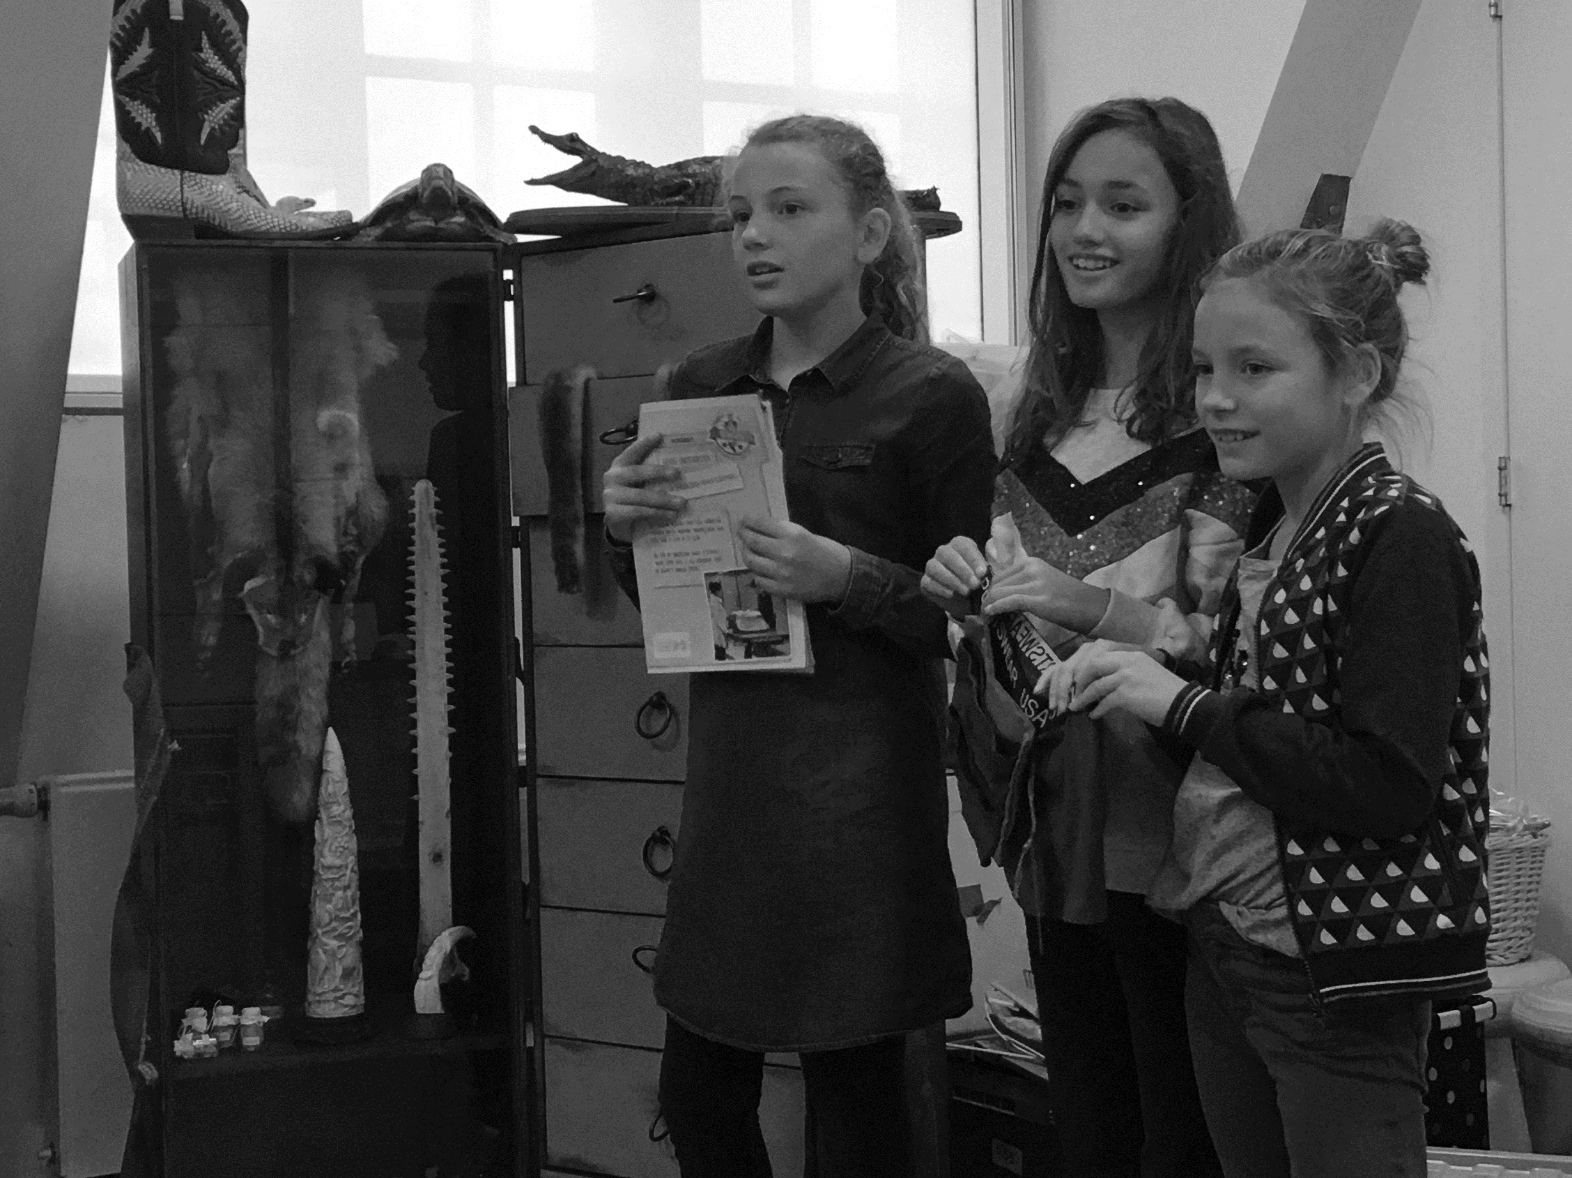
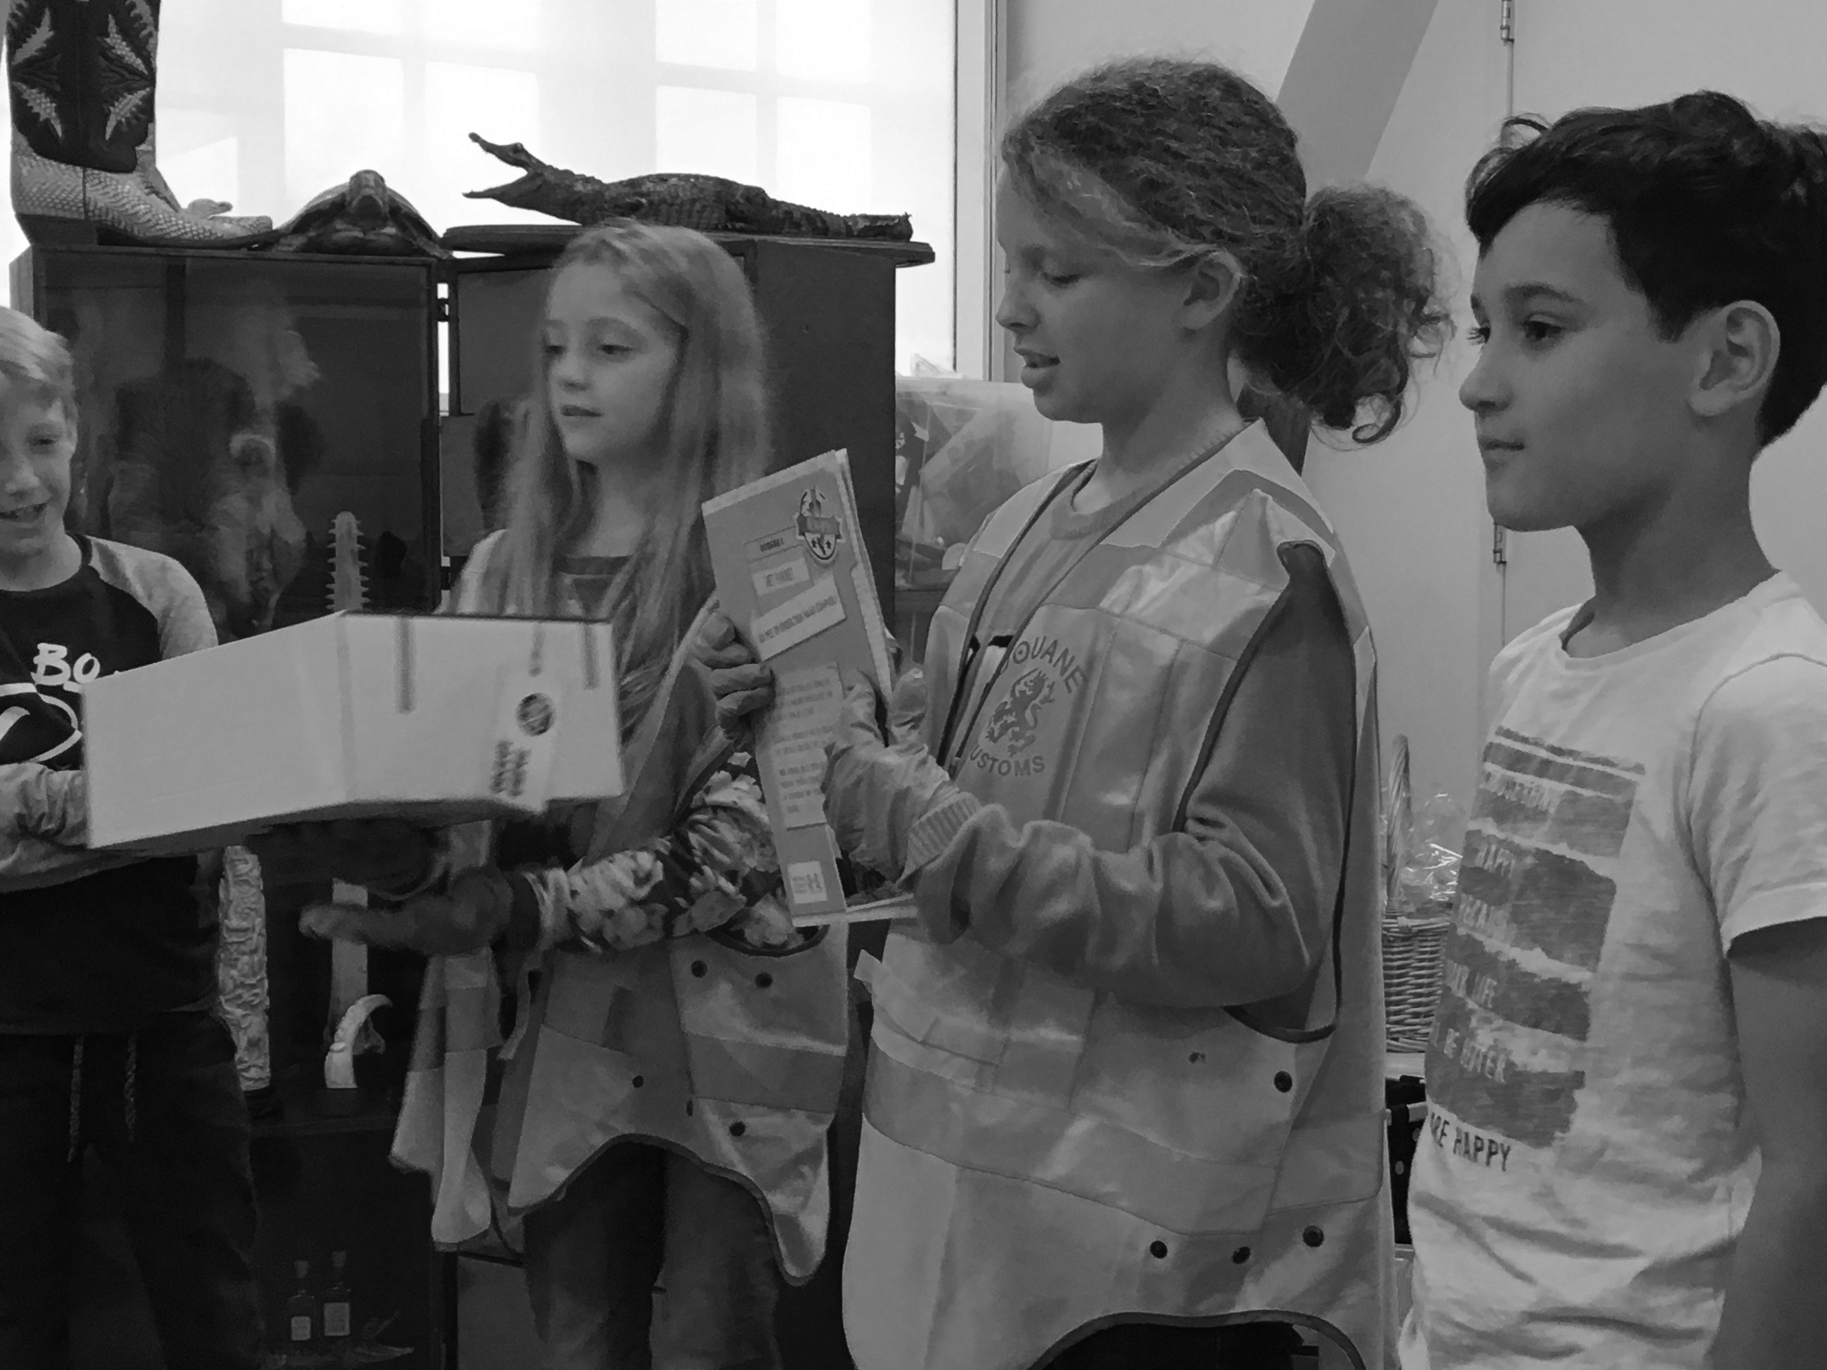

Slide 17
Find yourself some partners
take
your
chances

Slide 18
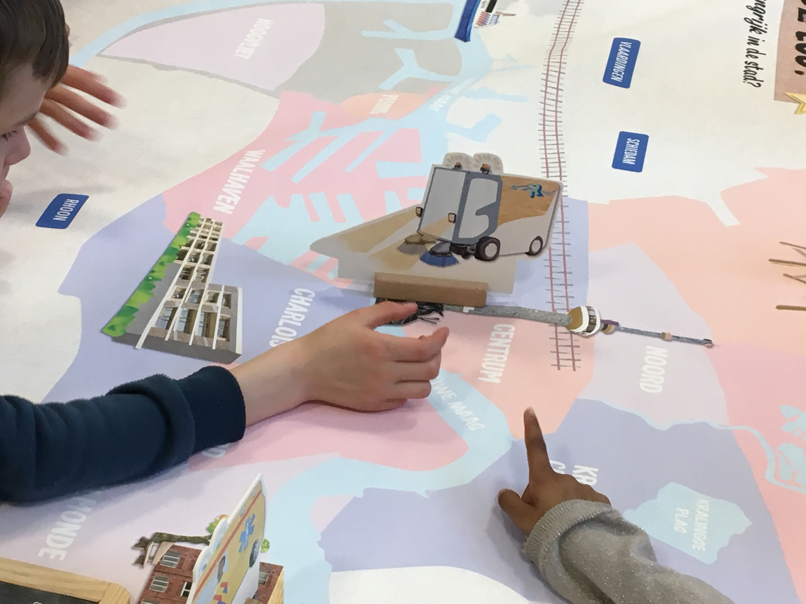
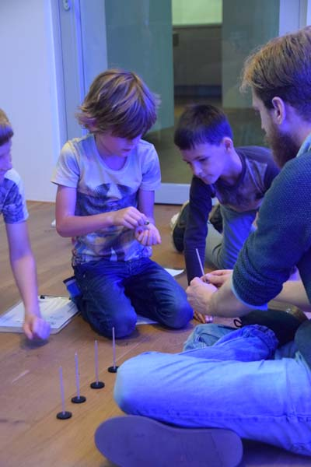
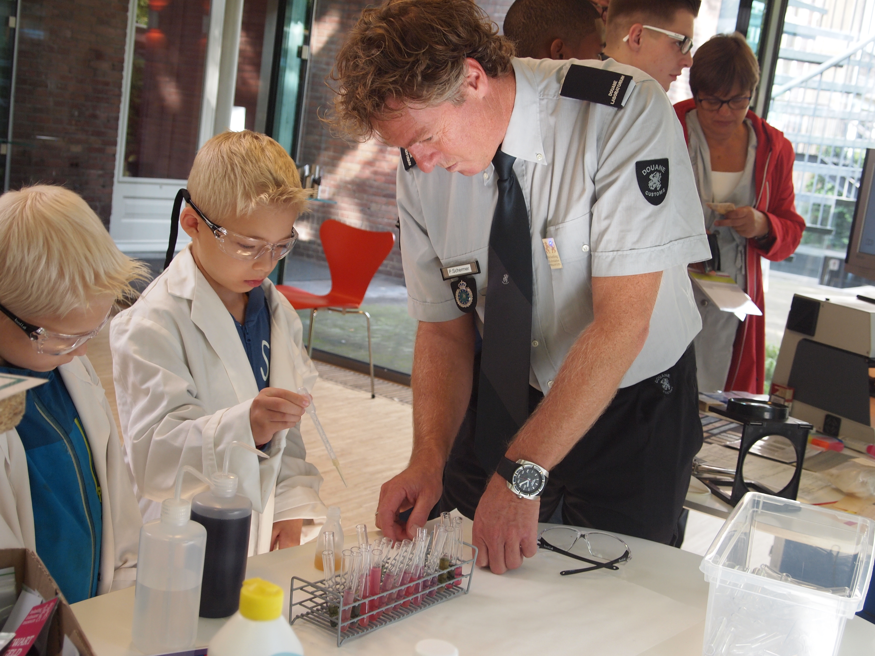

Slide 20
Become Future proof
take
your
chances

Slide 21
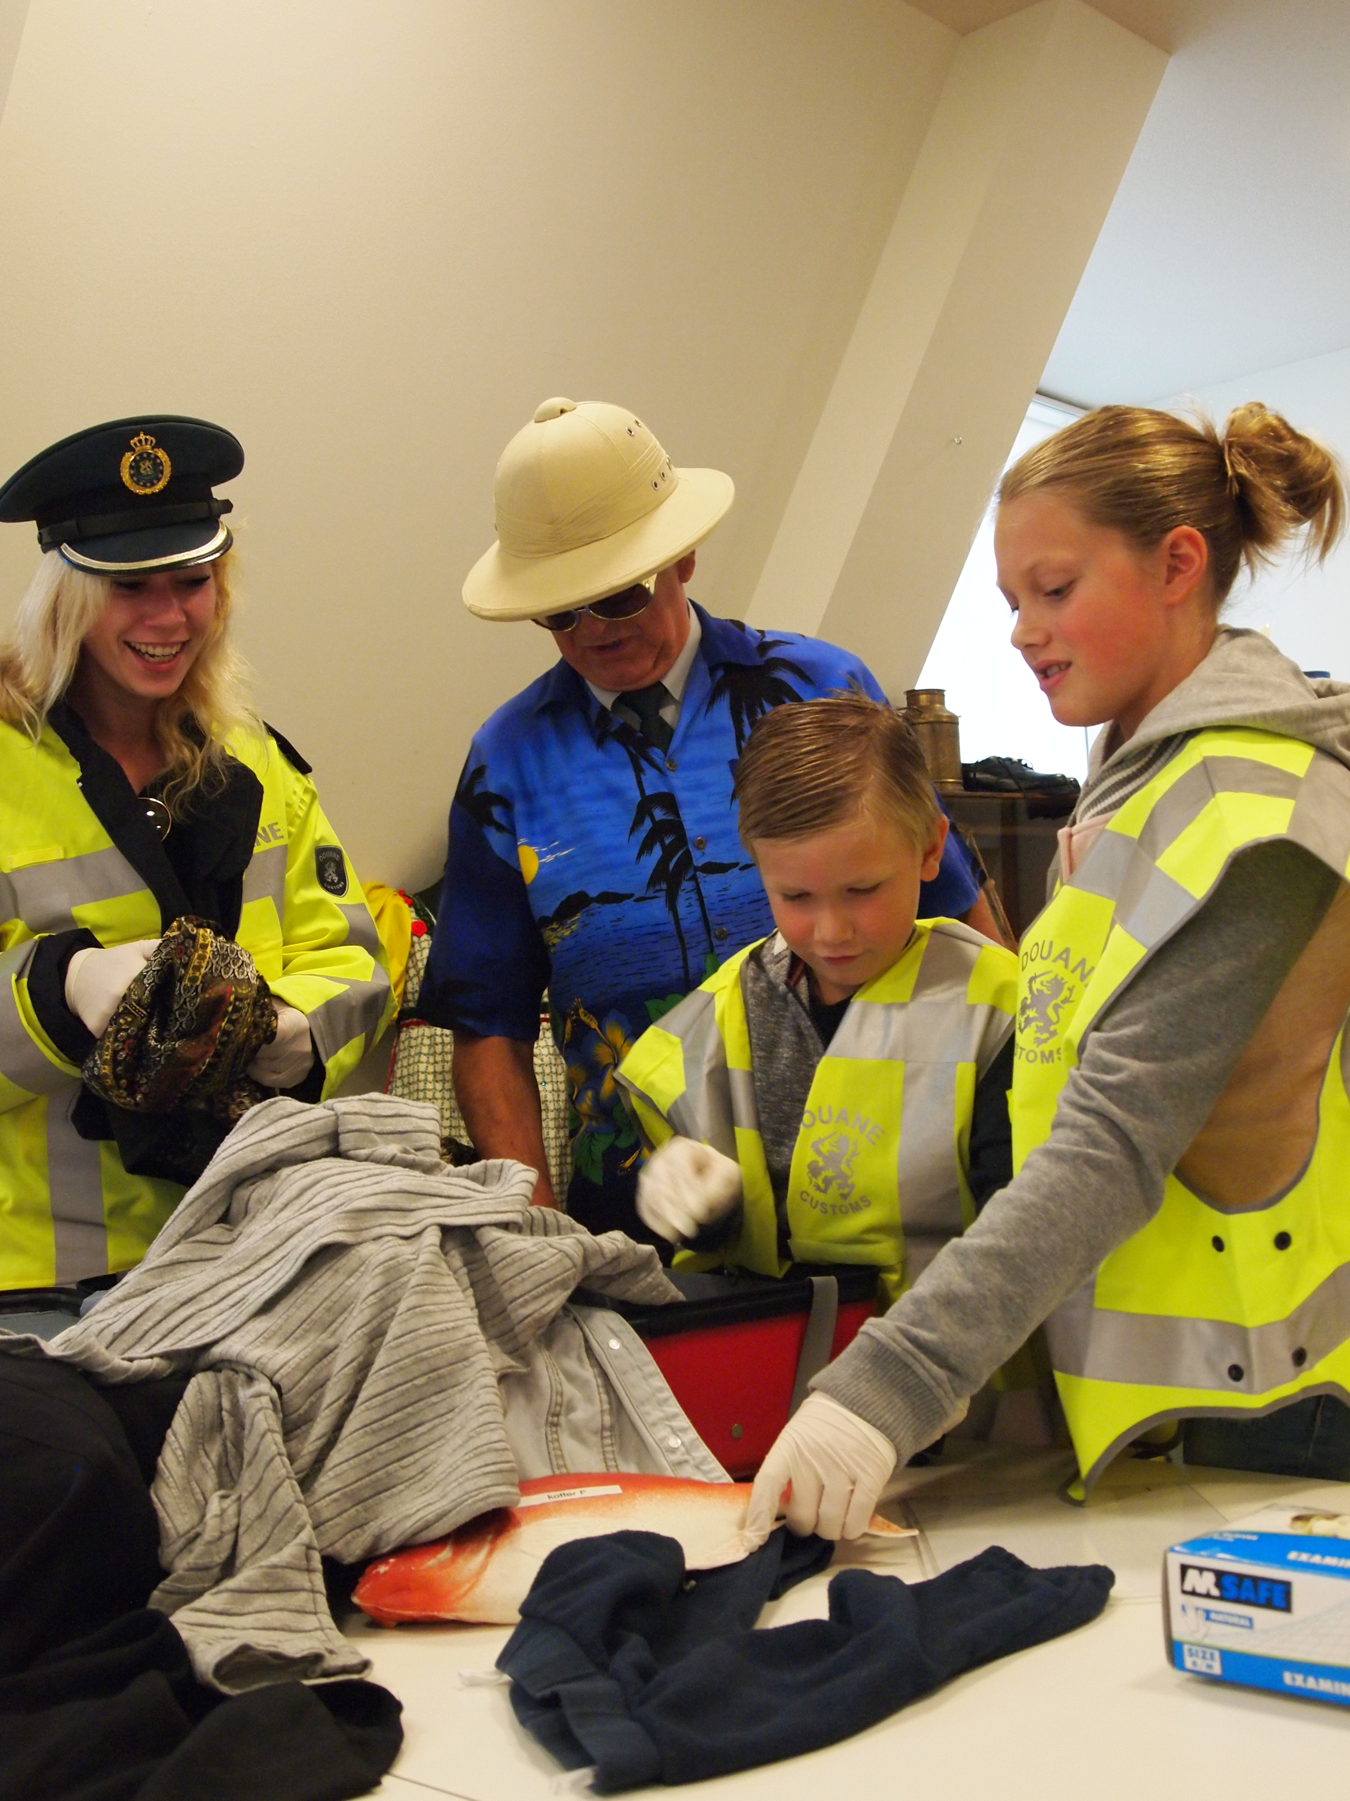
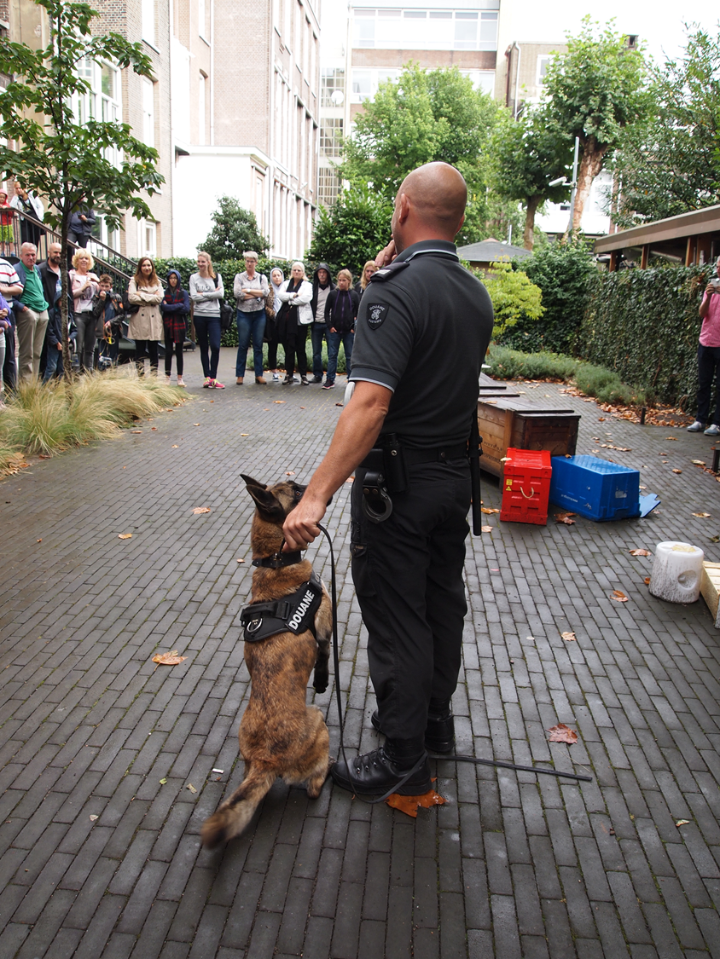

Slide 23
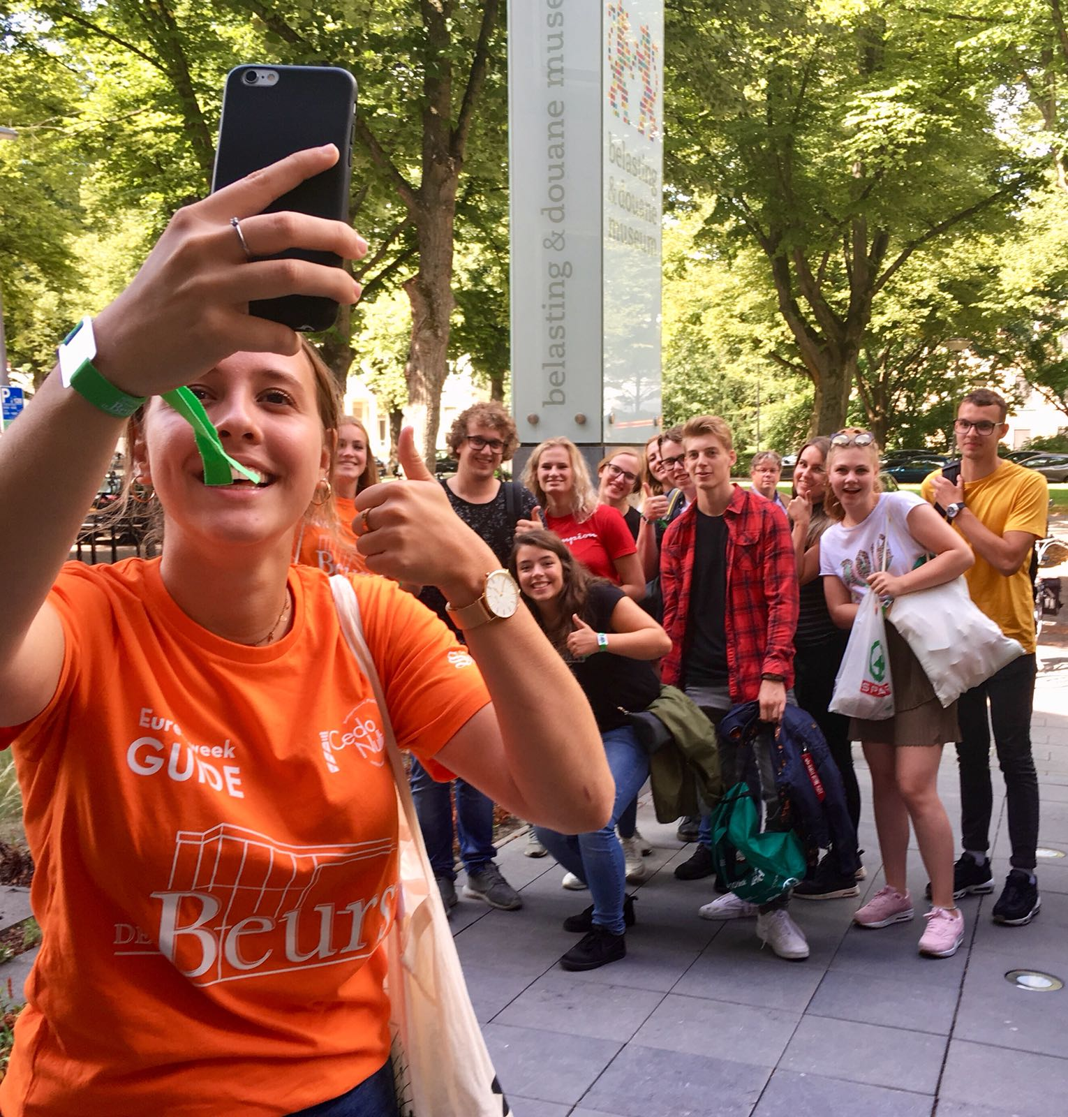

Slide 24
Questions?
take
your
chances

