Slide 1

EDUCATION IN ACTION
Vilnius, Lithuania
2018.
IACM

Slide 2





2011. The beginning of the integration
Customs and Finance Guard
Tax and Financial Control Administration
The National Tax and Customs Administration (NTCA)

Slide 3
The History of Tax & Customs Training
Customs and Finance Guard
Customs School
(Since 1909/1929)
National Tax and Customs Administration
Institute for Training, Healthcare and Culture
(Since 2011)
Tax and Financial Control Administration
Tax Training Centre
National University of Public Services/
Customs and Finance Guard Department (Since 2011)
Police College/
Customs and Finance Guard Department
Mihály Arnold
WCO Regional Training Centre
(Since 2017)
WCO Regional Training Centre

Slide 4
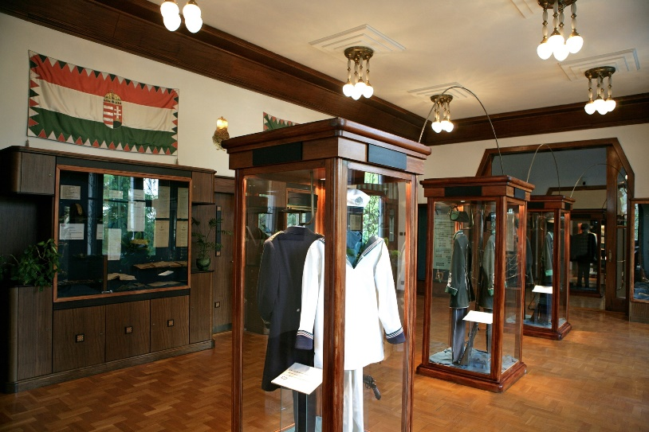
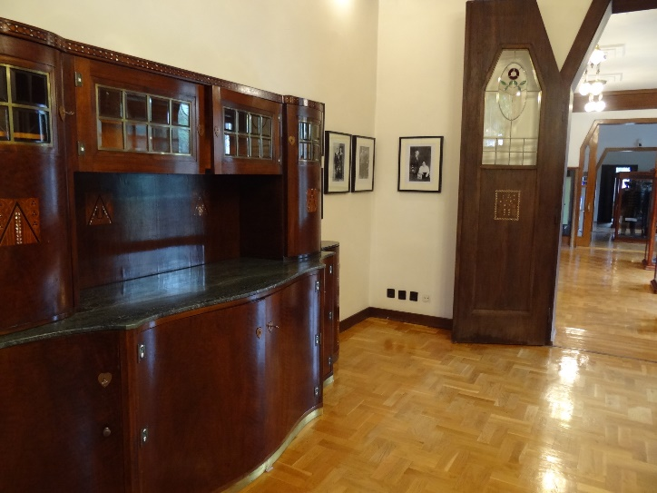
NTCA
Institiute for Training, Healthcare and Culture
In the framework of its training activities the Institute performs for :
- Customs guards
- Staff in government service relationship with the NTCA
Museum of the History of Finance Guards and Taxation

Slide 5
Training tasks of the Institute
To develop and provide job specific, competency-based trainings aiming at promoting the accomplishment of professional tasks
Operation and development of the training system
Cooperation with universities, colleges
Preparation of the annual training plan
Methodological support and coordination in the tax awareness programs for the young.

Slide 6

Training types
Basic professional trainings
Further professional trainings,
trainings for specialists
Vocational foreign language trainings
Refreshment courses
Soft skills trainings
IT trainings
Leadership development programs
Teaching methodology courses

Slide 7
Training forms
Class -room trainings
T-groups
eLearning
Blended learning

Slide 8
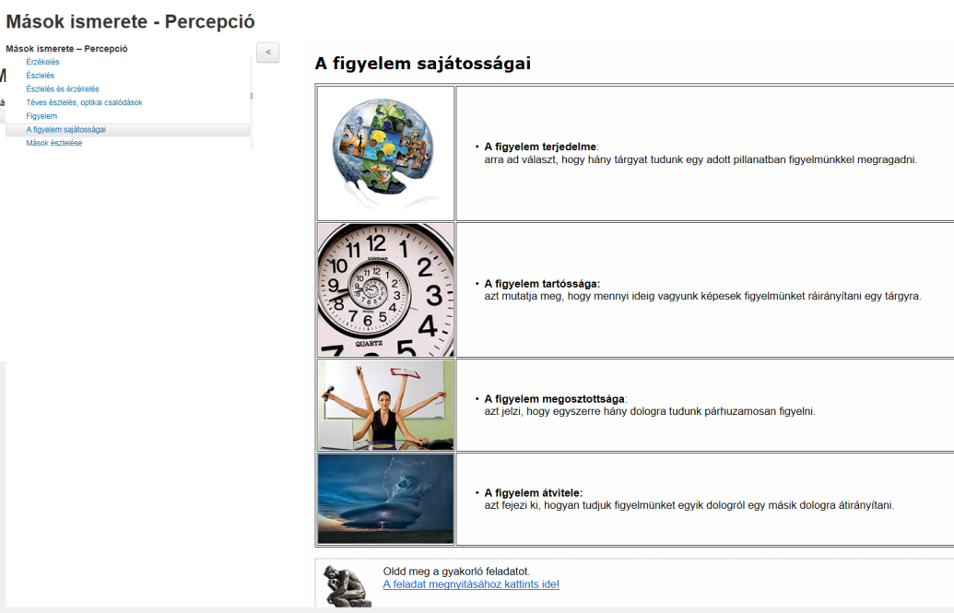
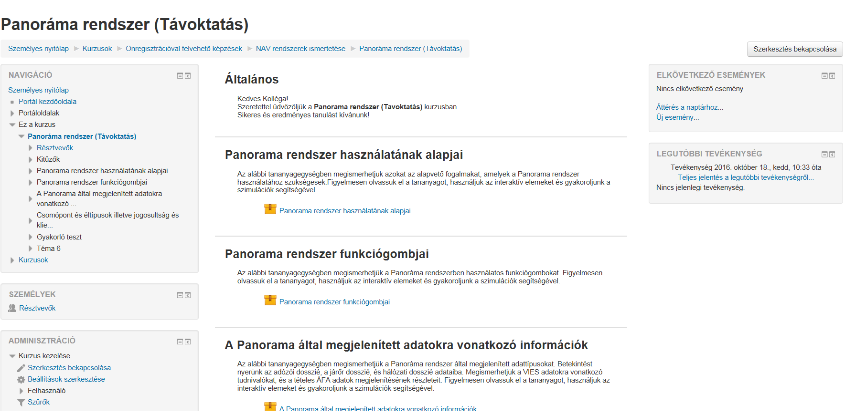
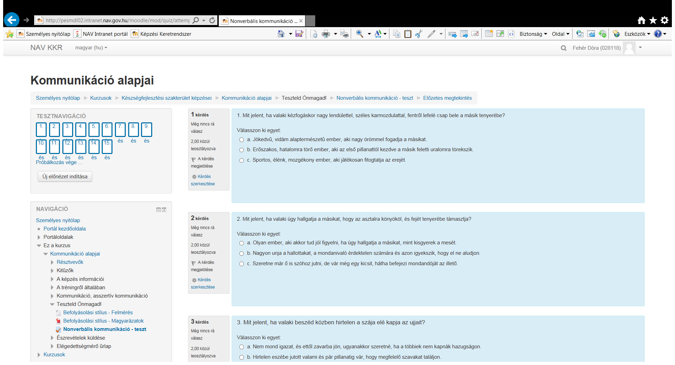
MOODLE
Simulations
Interactive e-learning materials
Videos, forums, wiki, tests

Slide 9


Prevention
- Tax awareness
- Compliance
- Shape the attitude of the young
- Information campaigns
The measures implemented by the NTCA are aimed at accomplishing in each type of secondary schools.
The primary target groups:
graduate students and the 11th class

Slide 10
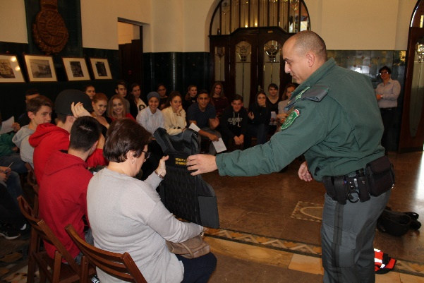
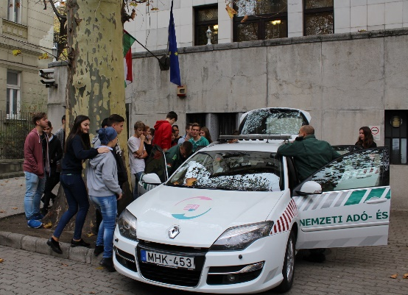
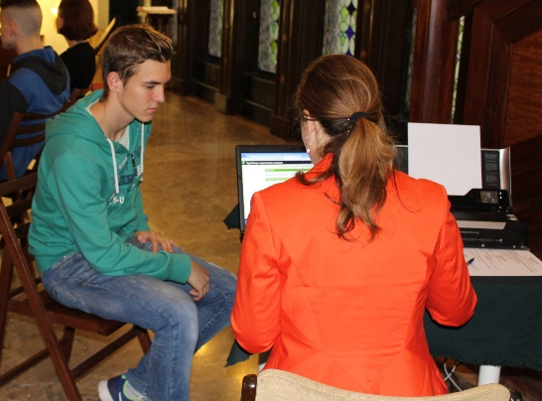
Parts of the program are:
- taxation history
-basic knowledge on taxation
- practical knowledge-sharing
- ways of communication with the tax authority
-opening of a Client Gate

Slide 11
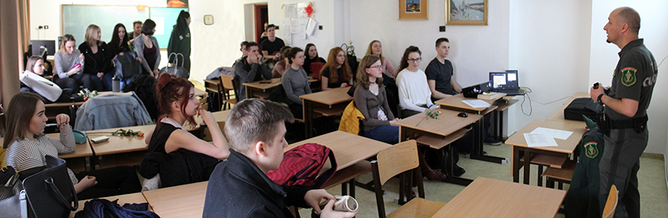
2016 – 2018.
Tax awareness – interactive structured group sessions for secondary school students
Szöveg

Slide 12
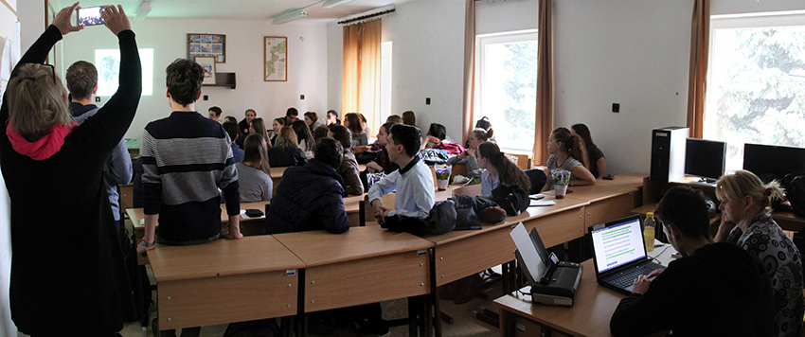
- Using methods based on playing
- Taking into account the specific characteristics of the age group
- Interactive pedagogy
- Equitable taxation
- Several important terms of taxation and the history of taxation
- Types of taxes in Hungary exist
- Legislate the tax laws and implement them - interactive sessions

Slide 13
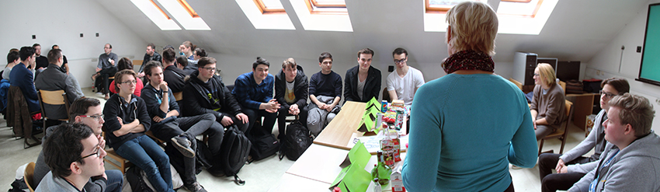
The colleagues of the NTCA try to provide a comprehensive overview of taxation and the tax authority using tools of the experiential and cooperative education.
- Organisational structure
- Geographical location
- Professional division of the administration
- Client Gate and its advantages

Slide 14

Night of Museums
2018
Entertaining and educational program

Slide 15

FAKE ACADEMY: exciting customs patrol training for children
AIRSOFT SHOOTING
TREASURE HUNTING game in the museum
Don’t be light: STOP FAKE PILLS!
SCARRY GOODS in the chamber of secrets
REAL or FAKE goods?
How do the TRADEMARKS protect us?
TAXEDU – TaxBuilds our future!
CUSTOMER SERVICE
PLAY THE GAME with NTCA
Exciting, fascinating tasks for all age groups!

Slide 16
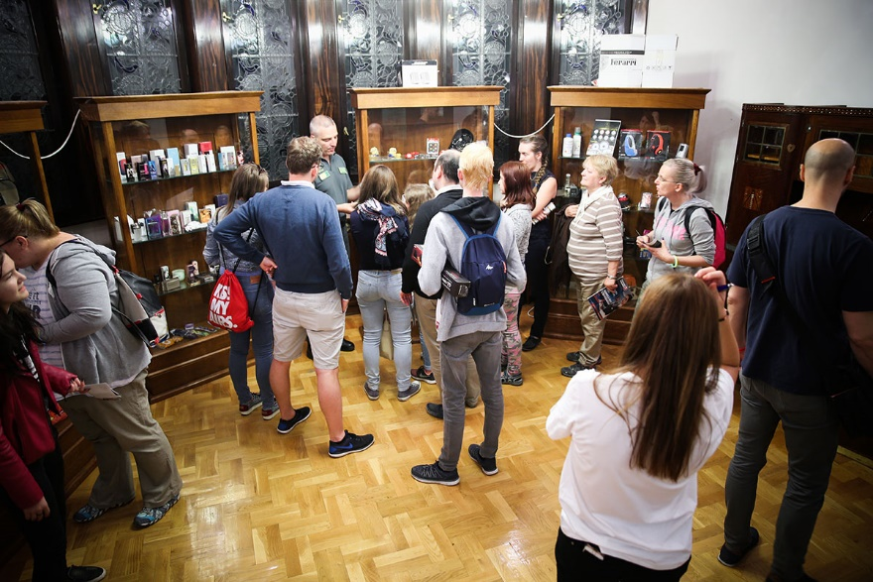

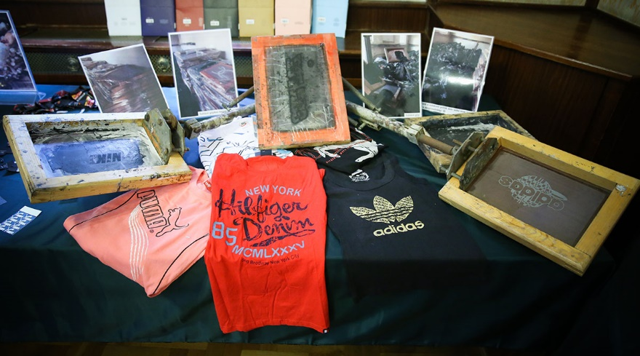
Temporary exhibition in the museum, presenting counterfeit goods

Slide 17
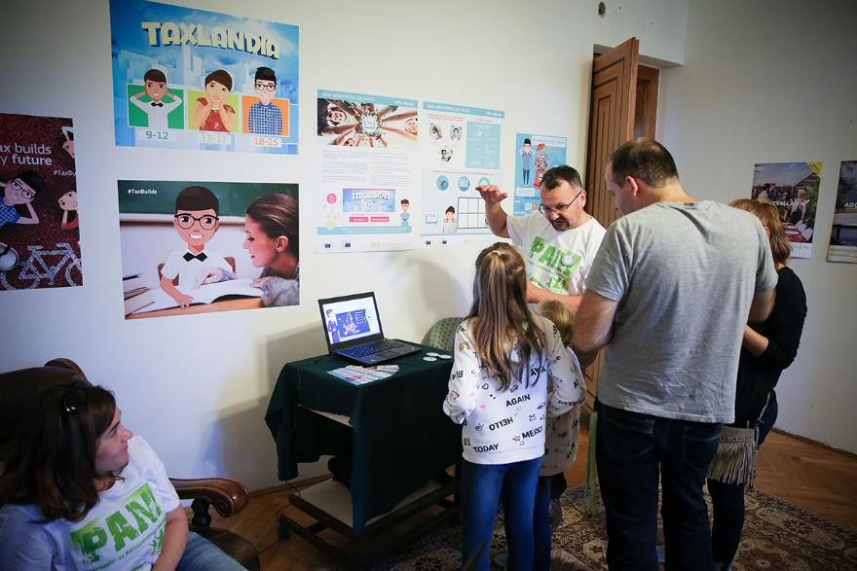
TAXEDU
The name of this portal – TAXEDU – is derived from the words
‘Tax’ and ‘Education’.
TAXEDU is a European Union pilot project. Its aim is to educate young European citizens about tax and how it affects their lives.
The portal targets three age groups with tailored information:
- Children
- Teenagers
- Young adults

Slide 18
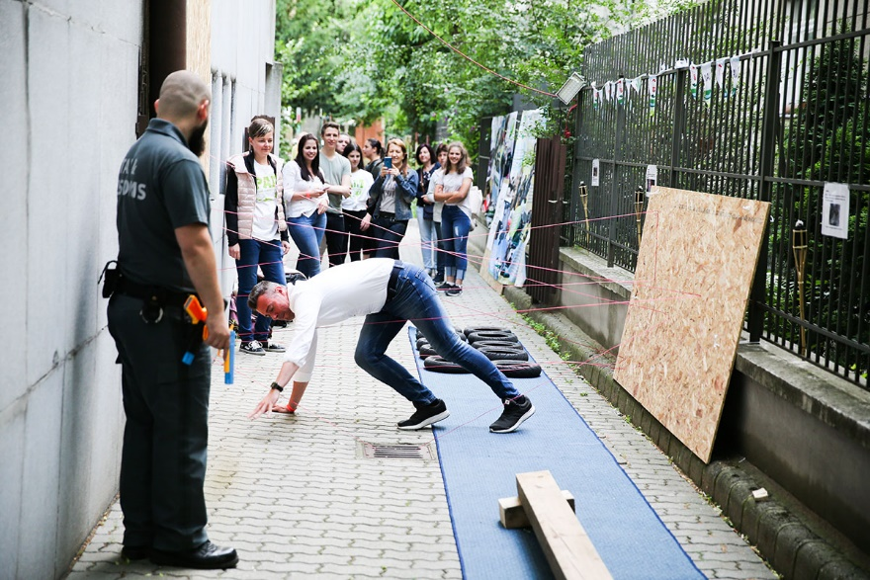
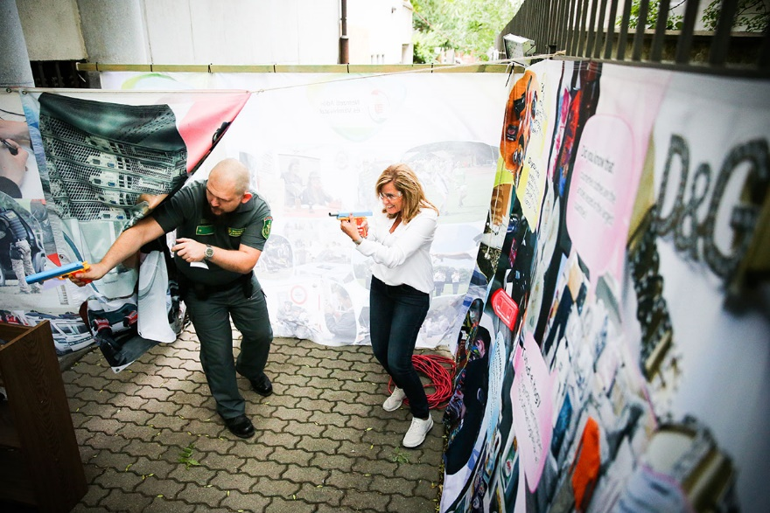
Exciting customs patrol training for children and adults alike
in the courtyard of the museum

Slide 19
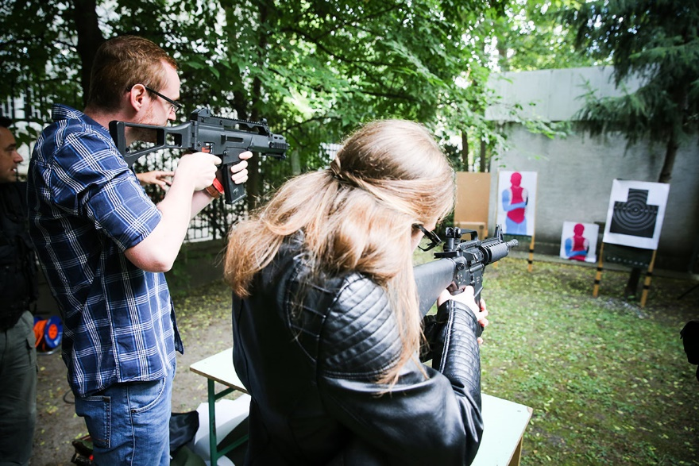
Airsoft shooting in the garden of the museum
Szöveg

Slide 20
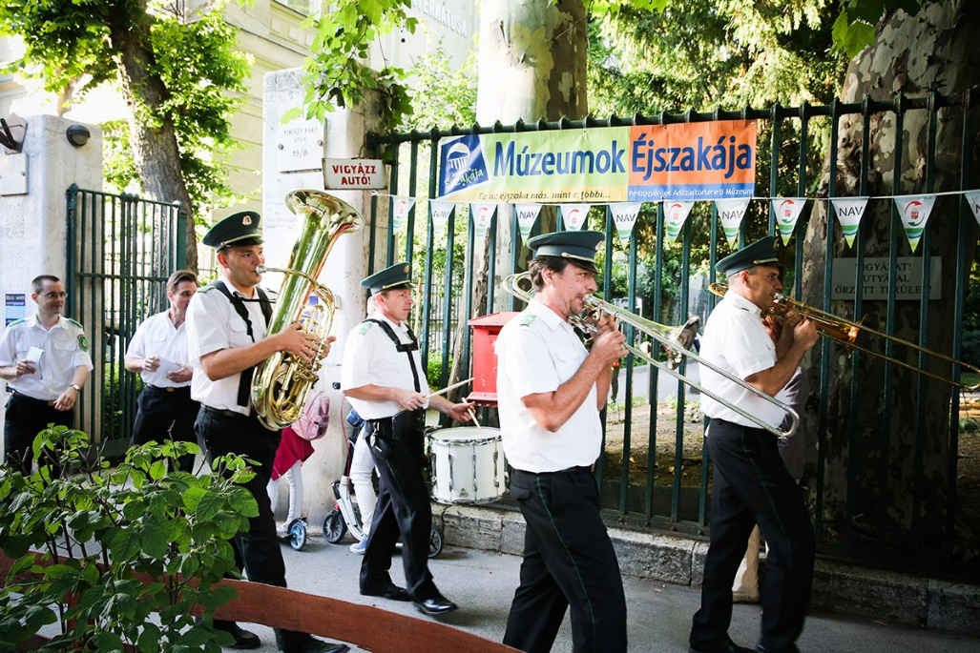
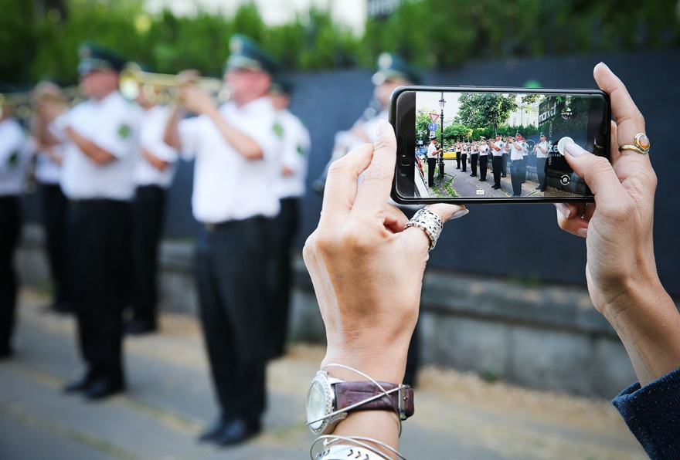
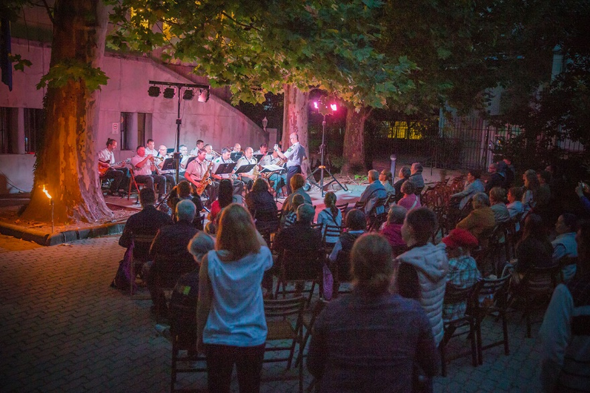
Marching of the Finance Guards’ Wind Band attracting the audience. Pleasant concert at summer night.

Slide 21

Thank you for your attention!

