Slide 1
”A Hundred Years Ago – A Customs History Campaign”
Janne Nokki

Slide 2
Centenary of Finnish Independence
6 December 1917: Declaration of Independence
January-May 1918: traumatic Civil War (battles, executions, prison camps, hunger, disease: 40 000 dead, 1,3 % of population)
In 1917 Finland already had own Customs administration and border control (since 1812)
To Customs, independence was a relatively easy task, most things were ready
But the following Civil War put customs officers in extremely difficult situation. Customs offices were in both Red and White areas

Slide 3
The Official Centenary Year in 2017
The emphasis of themes was a very general one:
”Together”, ”Finland´s strengths”, ”equality and democracy”
Diverse programme in both Finland and abroad
Coordination by the Prime Minister´s Office, the Project Secretariat and a regional network
Ministry of Finances coordinated agencies in its sphere, agencies had free hands to choose what to do
Events throughout 2017 since January 1st
Culmination Independence Day 6 December 2017
The centenary was extended to the difficult year 1918, in the name of national reconciliation
Customs participated to some centennial theme events, e.g. ”Sleep easy”, centennial project Comprehensive Security
In history commemoration, the Customs offered a very unique and different view

Slide 4
Centenary in 2017
One poster about the meaning and importance of Customs to the independence in to the permament exhibition
A book, ”Customs in Karelia” published in December 2017, history of the Russian border region and the old customs border 1812-1944. (Manuscript ready since 2011)
History campaign: minor articles as Press releases, social media, intranet, Customs Museum website
A joint Photograph Exhibition in the State Agency Building lobby: Contributions from all agencies that reside in the building

Slide 5
Historical Press Releases ”Hundred Years Ago” in 2017
Over 60 published articles with historical image via ePress media and via Customs website
First published in January 2017
Also Facebook, Twitter
Also in Customs intranet as blogs, sometimes lively discussion among Customs staff
Themes searched from the letter concepts of the Board of Customs (National Archives), publishing by date of document, local coverage, human or professional interest
A year of crises: economic misery, political unrest, the Russian Revolutions
Many releases found their way to media, especially local

Slide 6
Centenary Press Releases in 2018: The Civil War
Similar articles from the studied source material for exhibition texts (Customs archives, archives of the Red government, materials from the 1918 Investigation in Customs)
1918 somehow less interest, <- all media covered the Civil War in abundance, Customs got less attention
Continued in summer 2018 about the time after Civil War in Customs
Commemoration will continue in 2019 (Centenary of Prohibition 1919, Anniversary of Drug Detection Dogs 1969)

Slide 7
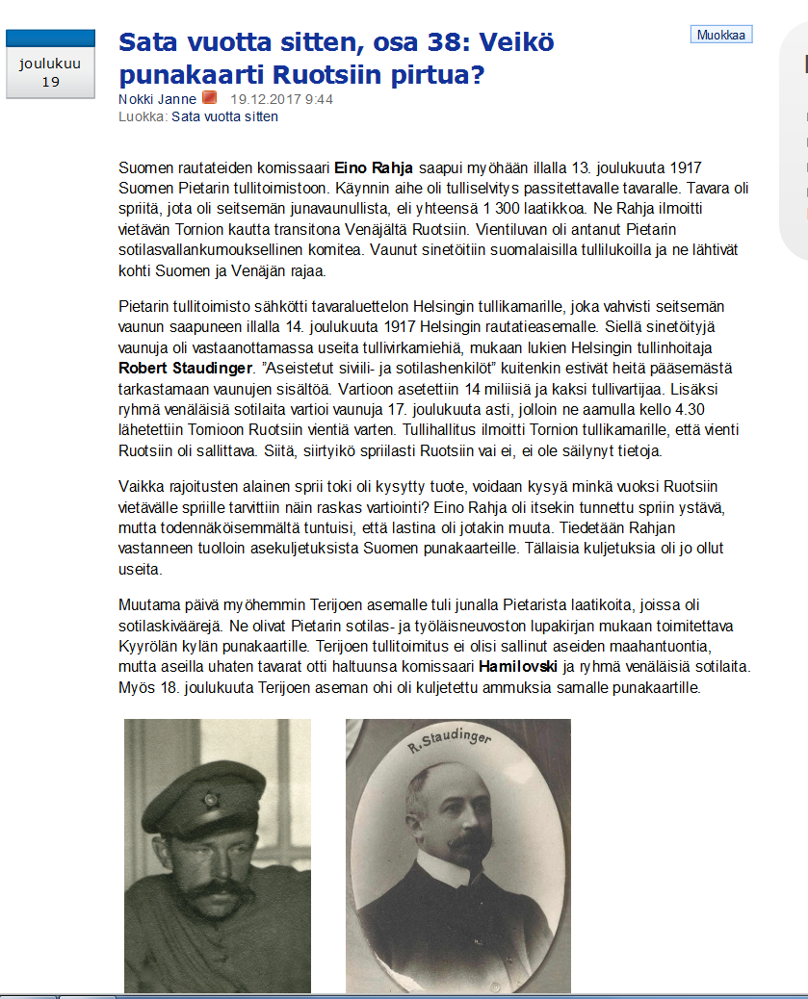
Customs Intranet

Slide 8
A Way to the Exhibition
The Museum is located in the Suomenlinna Fortress, in 1918 a prison camp for 8 000 people

Slide 9
An Overview Inside

Slide 10
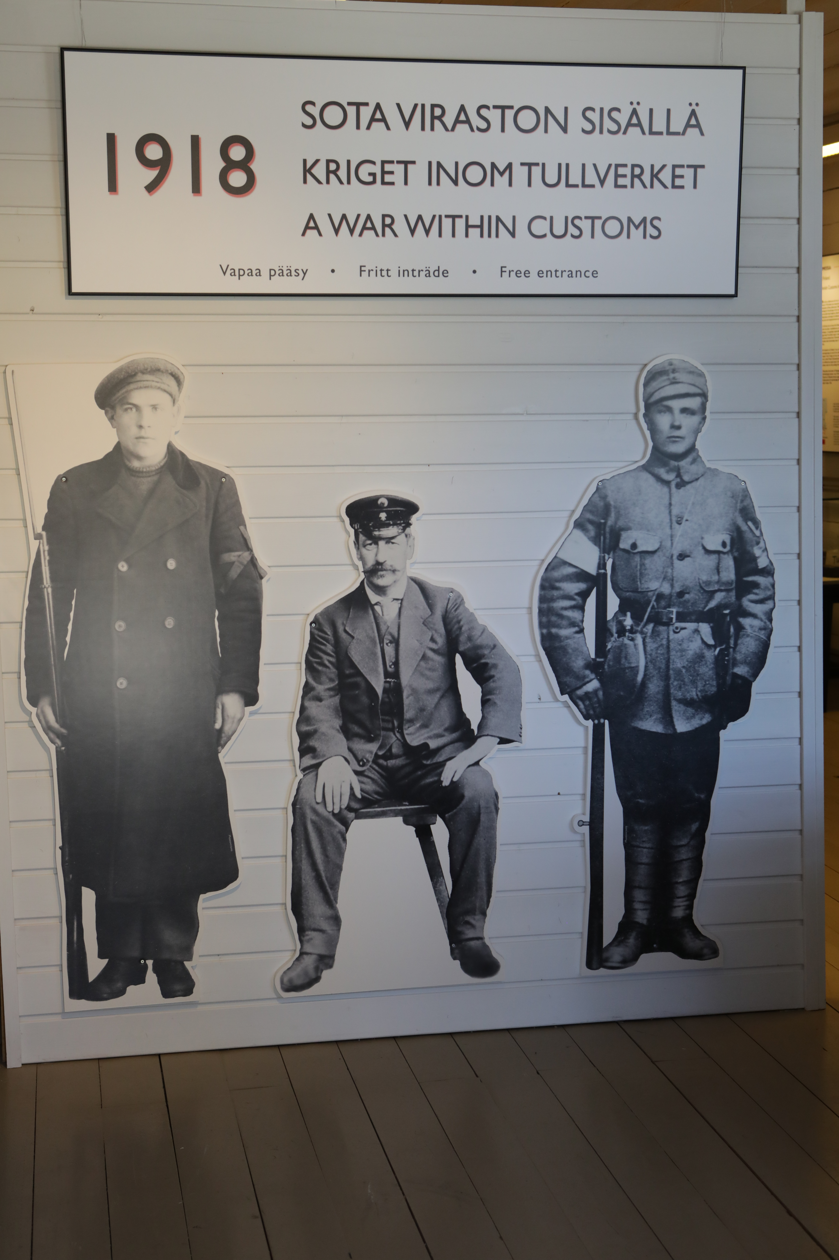
The Exhibition
Exhibition ”1918 - A War Within Customs” at the Customs Museum from 16 May to 31 August 2018. The publications as additional material
New, little known view to 1918
Names of all dead officers identified as ”memory plates”

Slide 11
Details of the Exhibition
One exhibition room
Loaned items from different museums, documents, uniforms, replicas
What happened to people in Customs, names of the deceased officers
Media interest to opening, TV news about ”Customs and Reconciliation”
New visitor record: 6 000 in 3,5 months Open from Tuesday to Sunday, free entrance
Aspects for the visitor: history of 1918, Customs in it, the building as part of the Prison camp organization

Slide 12
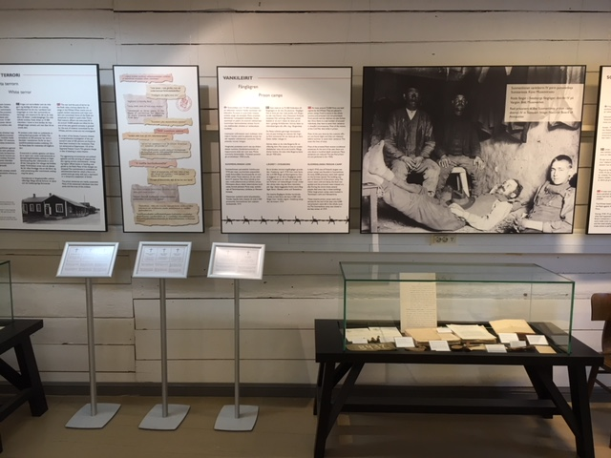
Exhibition Texts in 3 + 3 Languages

Slide 13
Experiences from a ”Total Exhibition”
Positive, especially the enthusiasm of Customs officers in the history of their organization which they knew nothing about
No negative feedback from visitors, though the subject is still extremely controversial, 30 years ago such exhibition would have been almost impossible
The Civil War interests both Finnish and foreign people alike. -> You can use major historical events to raise interest in Customs and its position. Foreigners knew nothing about Finnish Civil War while the Finns knew nothing about Customs in 1918
Very demanding (archival sources, finding contexts, publishing dates for releases, lack of photographs from 1918, loaned items)

