Slide 1
Education First

Slide 2
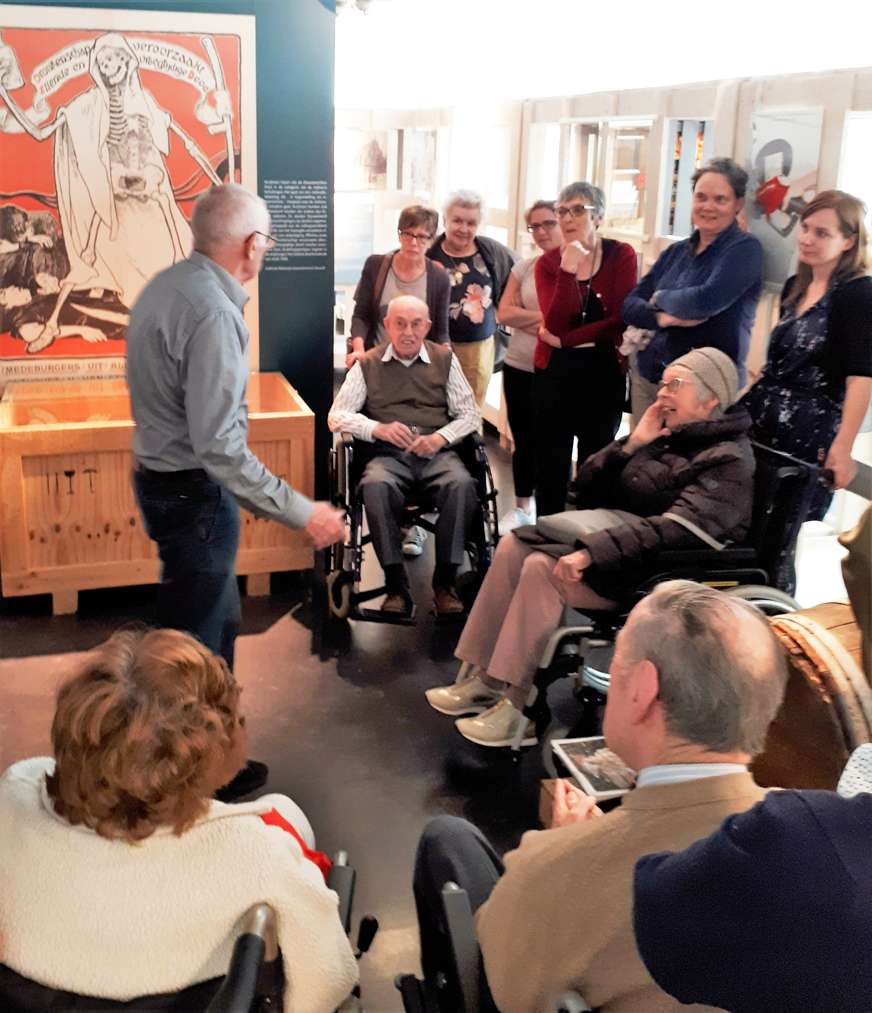
Education =
Education for primary and high school youth
Education for (national and international)
colleagues and stakeholders
Education for tourist groups /retirees associations/…

Slide 3
Krokuskriebels (“Spring Break tickles”)
Focus in this presentation is specifically on an educational project for children between 4 and 12 years: Krokuskriebels
Krokuskriebels = an event organised every two years by Gezinsbond (Flemish Family Association), focussing on activities for children between 4 and 12 which they can experience TOGETHER WITH their parents/grandparents/…

Slide 4
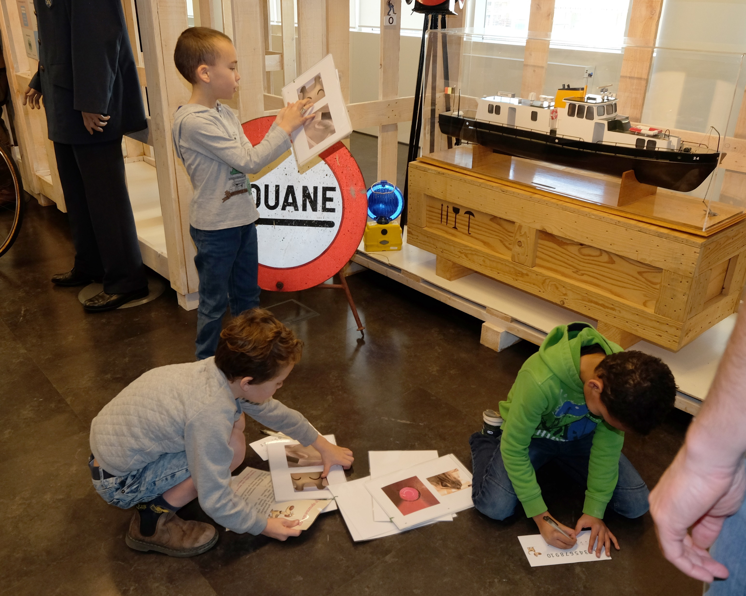
Photo search game

Slide 5
Photo search game

Slide 6
treasure hunt for figurines

Slide 7
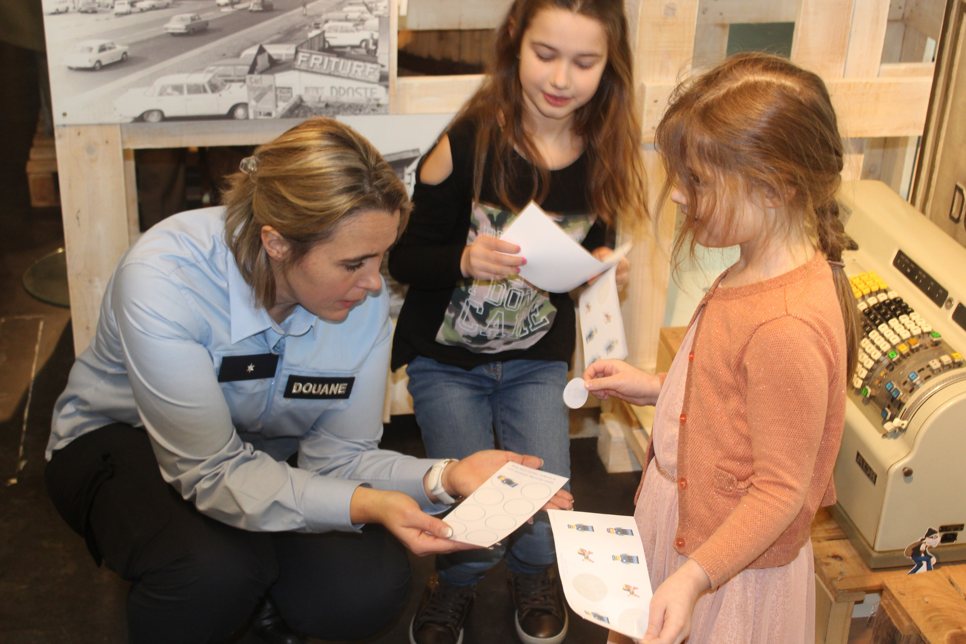
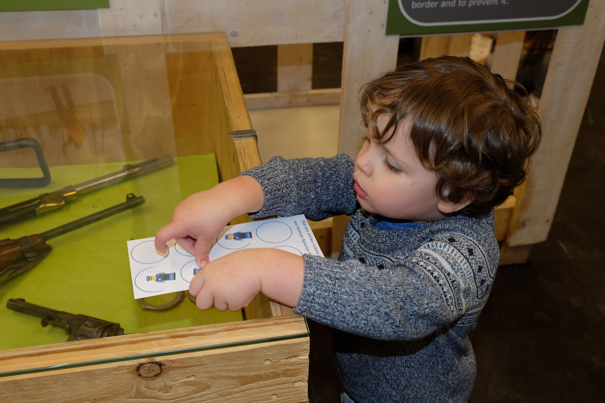
treasure hunt for figurines

Slide 8
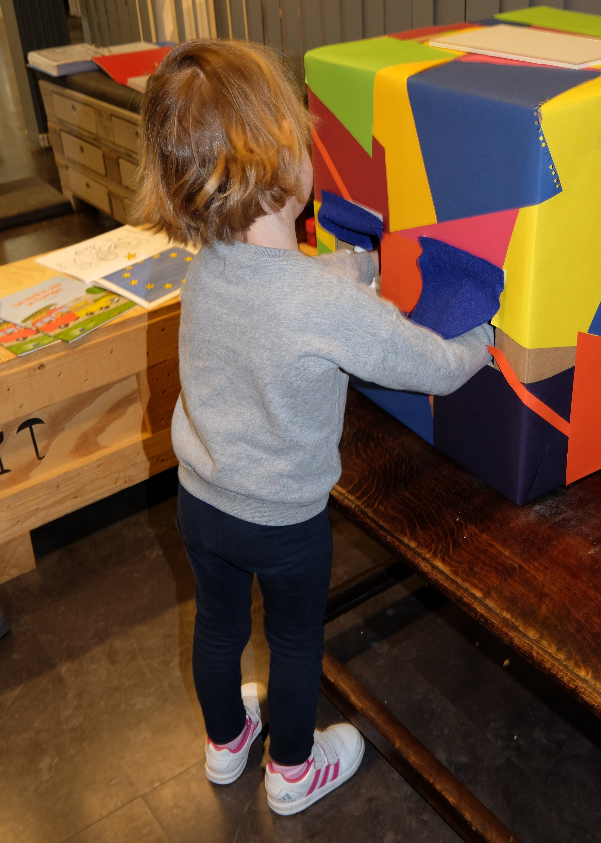
Feel boxes

Slide 9
Scent game: guess the scent and link to the real product

Slide 10
Suitcase: What can you take across the border and what not?

Slide 11
Suitcase

Slide 12
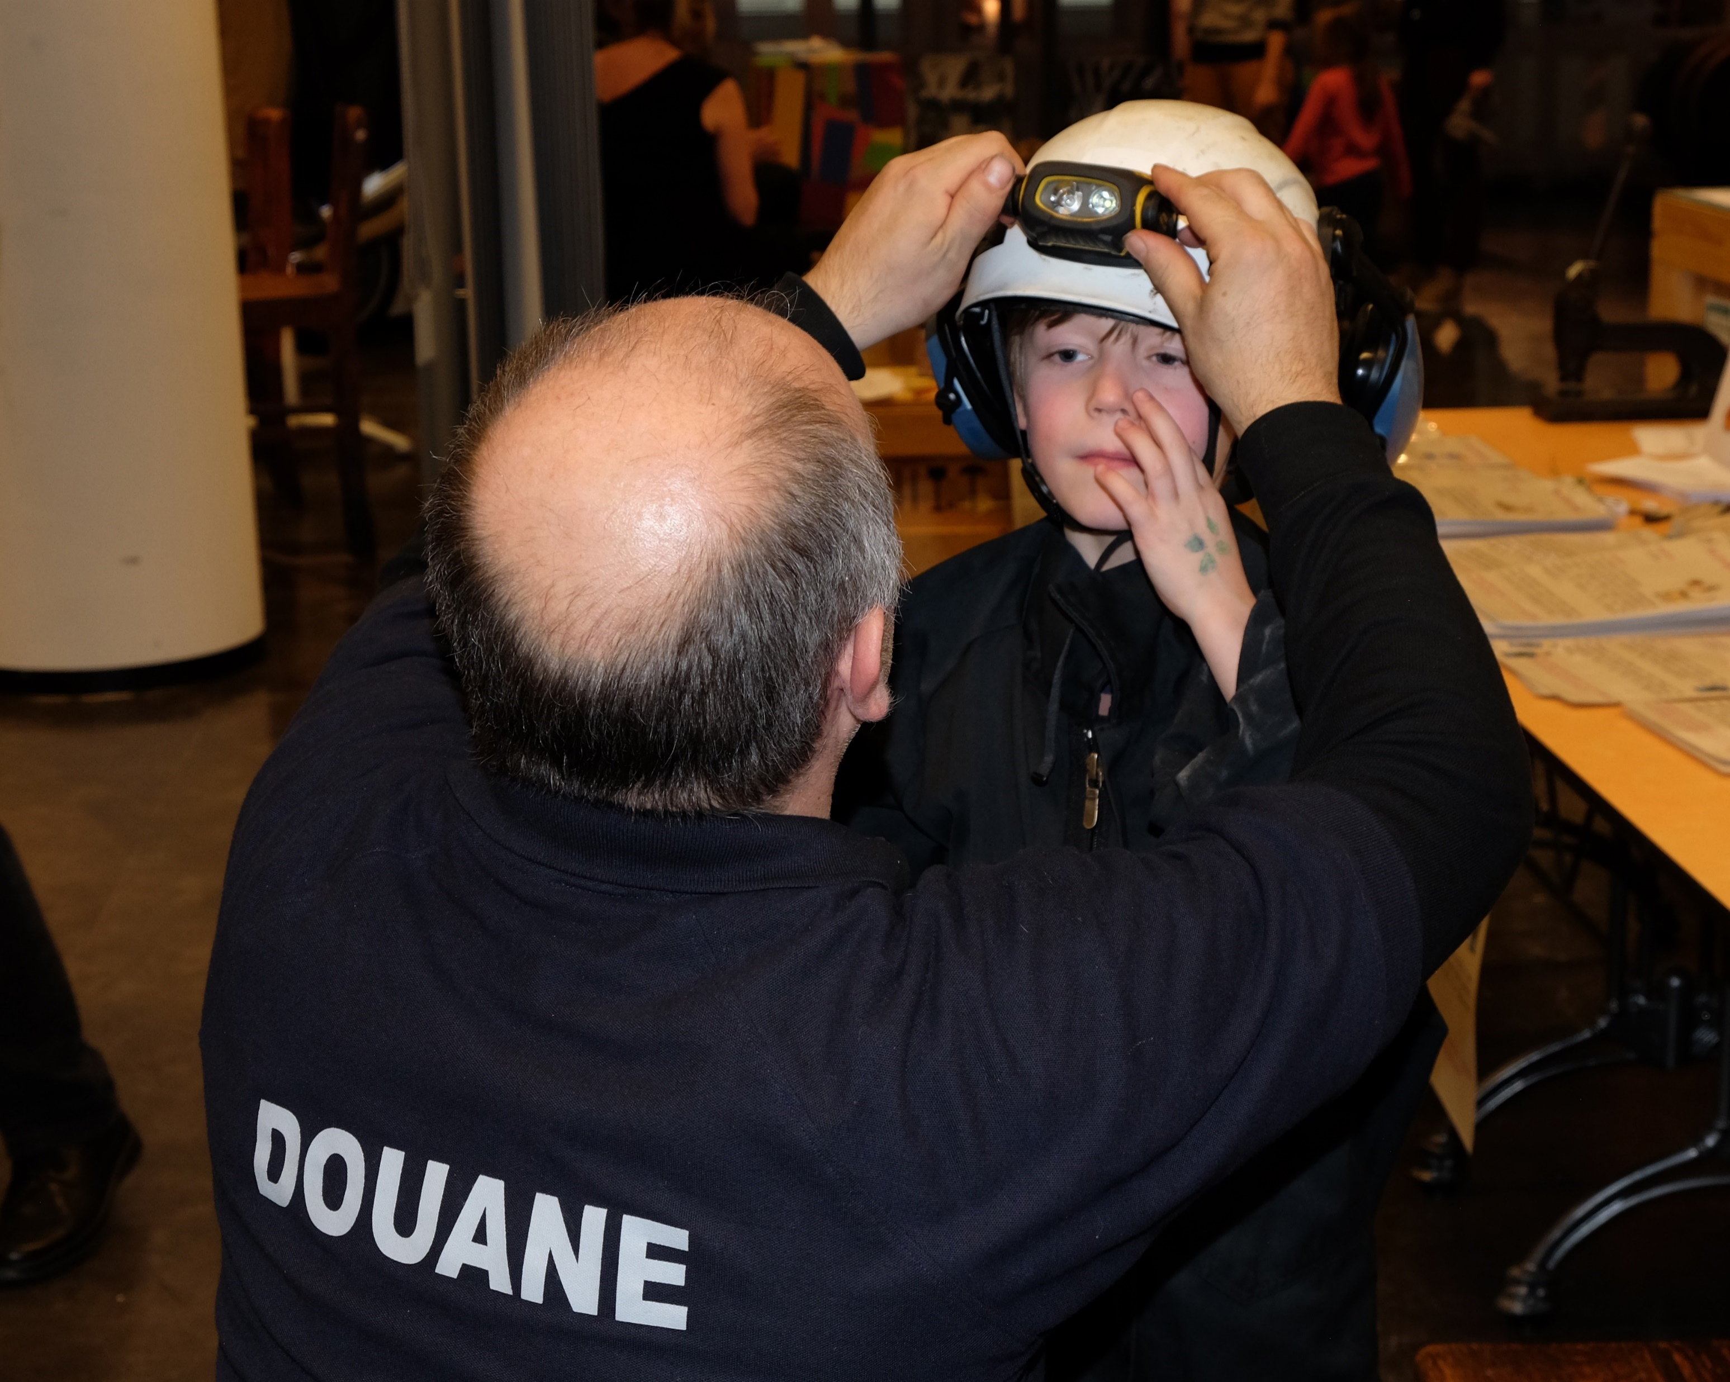
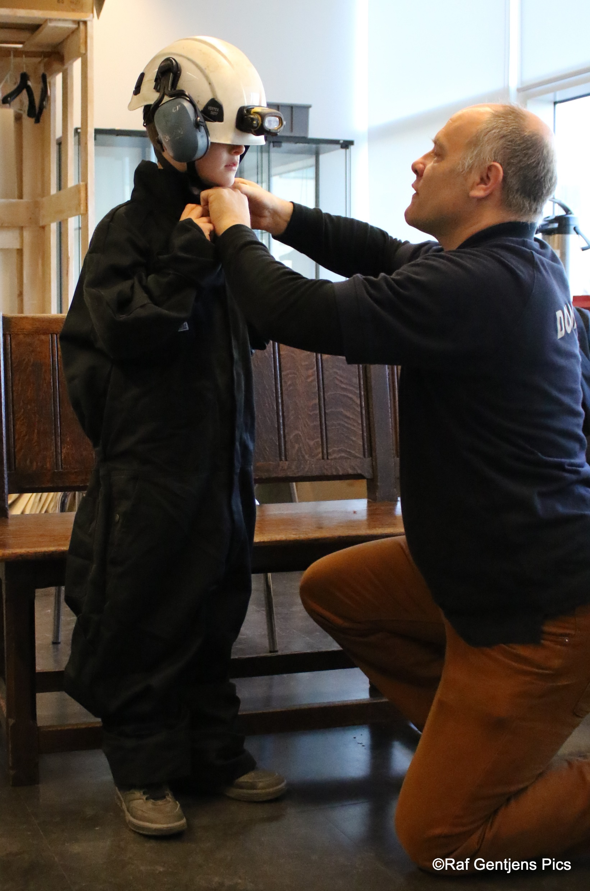
Rummage activity
Cooperation with active customs officers resulting in a rummage activity

Slide 13
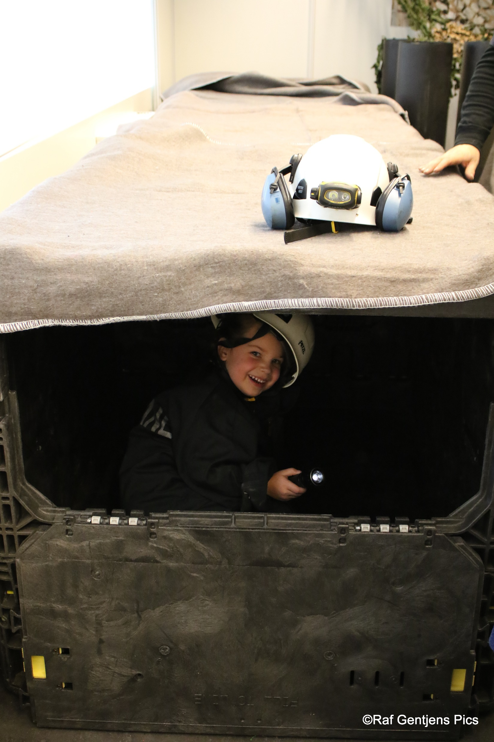
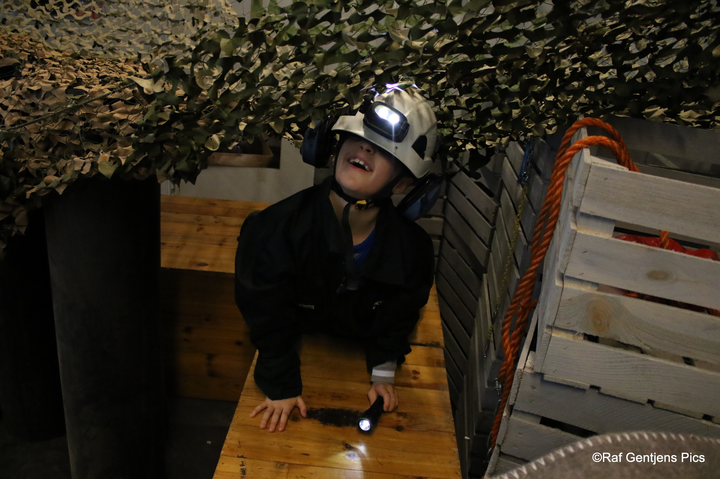
Rummage activity

Slide 14
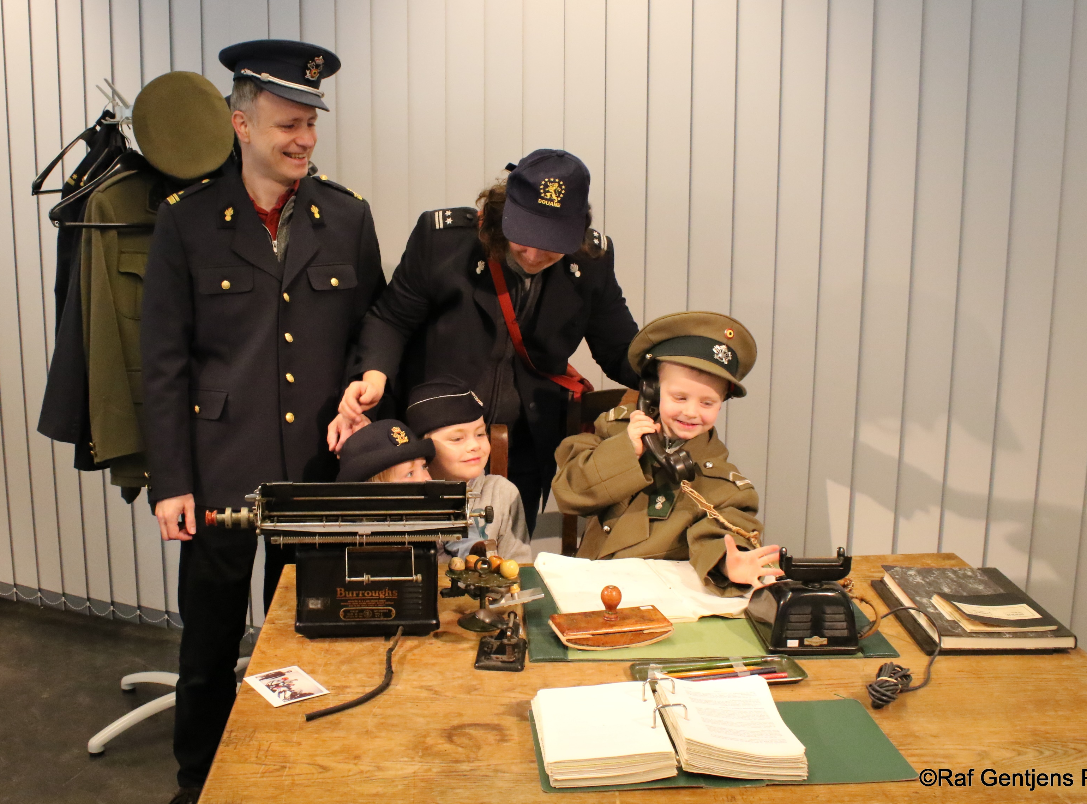
Picture time

Slide 15
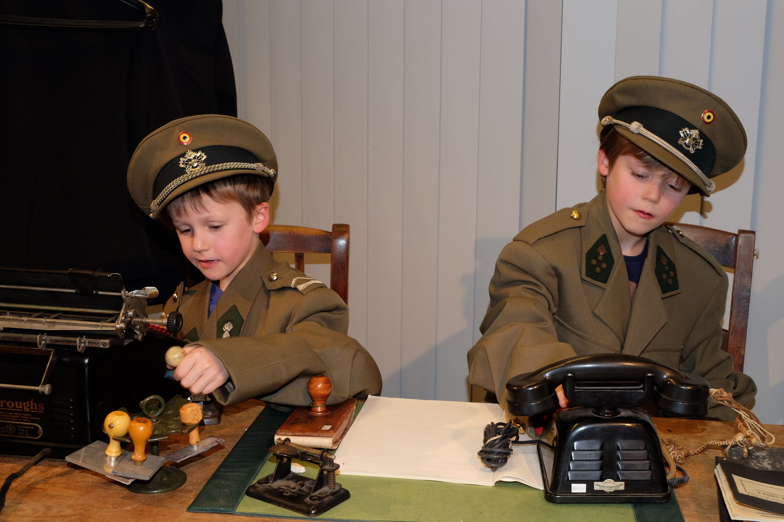
Picture time

